Slide 1
Catalyst
1. Nicki Minaj has brown eyes. Is this a phenotype or genotype?
2. Her allele combination is Bb.
a. Is this a genotype or phenotype?
b. Is this heterozygous or homozygous?
c. Use your answer from letter B. Is this a ______________ (put your answer from B here) dominant or recessive?
3. True or False. Alleles are combined in a specific, pre-determined order.
Wednesday Jan. 11th 2012

Slide 2
Announcements
Unit 5 Test on Tuesday
Study guide today
Unit 4 test make-up: tutoring on Thursday
Job meeting
If you applied for a job and were absent…
Standards packets (Photosynthesis AND Mitosis/Meiosis)

Slide 3
Big Goals
All students will develop, run, and present an original lab study from start to finish.
100% Proficient. 90% Advanced
At least 80% Mastery on all EOC and critical thinking level questions on all unit exams.
At least 5 points of growth on the ACT.

Slide 4
Are we on track to be 100% Proficient?
Discovery assessment data
Proficient or Advanced
Poster

Slide 5
Monohybrid and Dihybrid Crosses
http://www.siskiyous.edu/class/bio1/genetics/monohybrid_v2.html
http://www.siskiyous.edu/class/bio1/genetics/dihybrid_v2.html
Practice

Slide 6
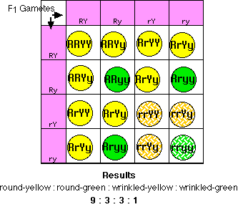
Monohybrid Cross/Dihybrid Cross
A monohybrid cross is a breeding experiment between P generation (parental generation) organisms that differ in one trait. (So, seed shape for example)
A dihybrid cross is a breeding experiment between P generation (parental generation) organisms that differ in two traits. (Mendel’s peas = seed shape AND seed color)

Slide 7
Punnett Squares
Developed by Reginald Punnett
used to predict the possible offspring of a cross between two known genotypes
(Genotype review)

Slide 8
Law of Independent Assortment
Mendel’s Law of Independent Assortment states that alleles are randomly distributed during gamete formation (Meiosis!)
A dihybrid cross will result in a probable ratio of 9:3:3:1
Meaning: 9 offspring of one genotype, 3 offspring of one genotype, 3 offspring of one genotype, 1 offspring of one genotype

Slide 9
Tomorrow….
Probability + Punnett squares Practice

Slide 10
CFU
Define genotype.
Define phenotype.
We use a monohybrid cross when the parents differ in ___________ trait.
A dihybrid cross is when the parent generation differs in _____________ traits.
What do we use Punnett squares for?
T or F We can predict both the phenotypic and the genotypic outcomes with a Punnet square.
A dihybrid cross results in a ___ : 3 : 3 : _____ outcome.

Slide 11
Study Guide
We will use the rest of class to work on our study guide for Tuesday’s test.
We may have not covered all the material on the study guide yet. Do the portion you know how.
Due on Tuesday

