Slide 1
Match the vocabulary word to its definition.
A. Characteristics passed
on by parents
B. Chromosomes (one
Chromosome from
Each parent) that make
Up one pair
C. Sex cells that have half
The number of
Chromosomes
D. The combination of
One gamete with another
E. The production of non-somatic sex cells (gametes).
F. Characteristics passed down from one parent to another .
Gamete
Homozygous chromosomes
Gene
Fertilization
Trait
Meiosis
Catalyst

Slide 2
Announcements
Dojo points: 35, 50, 75, 100….
Class points
teamwork, respect, cooperation, hard-work, participation, enthusiasm, meeting expectations, following directions
Job Applications!

Slide 3
Seating Chart
Instead of making everyone move, we are going to be doing some rearranging over the next few days.
You are expected to sit in your assigned seat every day. Failure to do so will result in a warning. (Yes, I notice when you don’t sit where you are supposed to.)
ABSOLUTELY NO WHINING ABOUT PLACEMENTS. YOU WILL NOT CHANGE MY MIND.

Slide 4
Big Goal
All students will develop, run, and present an original lab from start to finish.
100% Proficient; 90% Advanced
At least 80% mastery on all EOC level and college-level questions on unit exams.
At least five points of growth on the ACT.

Slide 5
ACT Diagnostic
Diagnostic: Where you are now
ACT scale
Second semester focus: Where you want to be
How will we do that?
ACT strategy tips, practice passages/questions, ACT days

Slide 6
Visible Tracking
We will be taking ACT practice tests in the future.
Our goal is for everyone to move at least five points from their original start.
Students who meet this growth goal will be recognized and rewarded at the end of the year!

Slide 7
SWBAT…
Articulate the origins of the study of genetics
Discuss Mendel’s experiments with pea plants

Slide 8
Cornell Notes
Cornell Notes are a good way to organize a lot of information
Three sections: Key points, Details, and Summary
Key points are in orange.
Details are in pink.
We will write our summary together.

Slide 9
Hook
Tell me about your favorite pet. What color was it? How did it look?

Slide 11
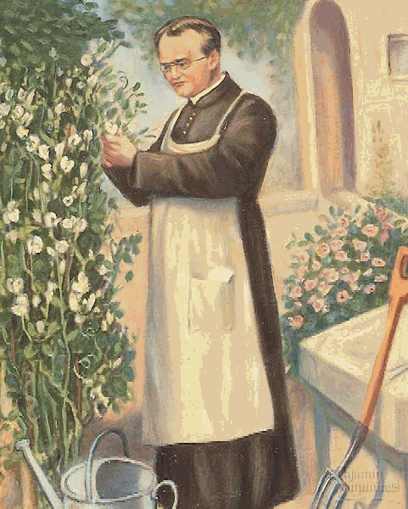
KP #1: Gregor Mendel explained how traits are inherited based on breeding pea plants. He is the father of genetics.
Gregor Mendel was a monk who bred pea plants.
The passing of traits to the next generation is called inheritance, or heredity.

Slide 12
Pea plants produce offspring with only one form of a trait. (Unlike Baby Jayonce!)
Pea plants normally fertilize themselves (gametes combine in the same flower). Mendel cross-pollinated, or transferred gametes from one flower to another.

Slide 13
KP #2: Through his experiments, Mendel observed how different traits were passed down from generation to generation.
Pea plants made specific forms of trait. Some always produced round seeds; others always made wrinkled seeds.
Mendel cross-bred a wrinkled seed plant with a round seed plant. This was the parent generation. (P)

Slide 14
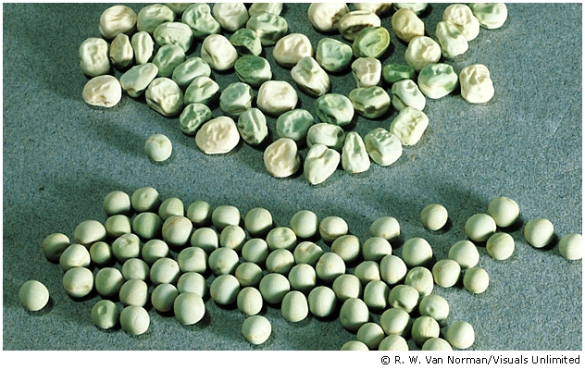

Slide 15
When Mendel bred the pea plants, all the offspring had round seeds. The wrinkled seed trait disappeared. (F1 generation)
Where did it go??

Slide 16
He bred the F1 generation. Those offspring had exactly one fourth wrinkled seeds. The rest were round.
Mendel studied 7 different traits: we are going to concentrate on seed color (green or yellow) and seed shape (wrinkled or round).

Slide 17
http://science.discovery.com/videos/100-greatest-discoveries-shorts-genetics.html

Slide 18
Exit Ticket/Homework
Mendel wrote in a journal about his pea experiments. Pretend you are Gregor Mendel and you have just bred the parent generation and gotten only round seeds.
Write a journal entry talking about these questions.
Why are all the seeds round?
What happened to the wrinkled seeds?
What should you do to answer these questions?
Your journal entry must be at least two paragraphs (6 complete sentences each). Remember you are writing as Gregor Mendel!! You may draw, etc.

Slide 20
Catalyst: Friday, Jan. 5th

Slide 21
Announcements
Unit 4 Test Make-Up
SEMESTER EXAM MAKE-UP
Standards Packets for Unit 3 and Unit 4 tests
Saturday tutoring
Homework turn-in

Slide 22
Unit 4 Test Tracking
Curved grades = when the test was difficult for the highest performing students in class, I add points to your score to make the grade more fairly reflect your ability
Remember, mastery is different than your grade!
Using our “calculators” to calculate our mastery

Slide 23
Dojo Review
35 is our first milestone!!
Everyone’s total points and total class score report

Slide 24
Mendelian Genetics cont.
We are going to continue using our Cornell Notes.
Remember, key points are orange. Details are pink.

Slide 25
Where did we leave off?
Who was Gregor Mendel?
What is inheritance?
Why did he choose peas to study?
What happened during his first round of experiments?
What kind of traits was he studying?

Slide 26
KP #3: From his experiments, Mendel concluded that there must be two forms of every trait.
Remember, Mendel was studying traits like seed shape.
Mendel decided each trait has two forms (wrinkled or round, i.e.) and each is controlled by an allele.
allele: one form of a trait passed down by a parent.
The wrinkled and round traits were different forms of the same gene.

Slide 27
Remember when Mendel bred his F1 generation? All the seeds were round and none were wrinkled.
The form of the trait (round) that appeared is dominant. The form of the trait (wrinkled) that was gone is recessive.
So, in a cross between wrinkled-seed plants and round-seed plants, the round seed shape was dominant.

Slide 28
KP # 4:Inheritance can be modeled using a special code.
The dominant allele (i.e. round) : an upper case letter
the recessive allele (i.e. wrinkled): a lowercase letter.
Round: R
Wrinkled: r
An organism with two of the same alleles for a specific trait is homozygous. An organism with two different alleles for a specific trait is heterozygous.
Homozygous round seeds: RR (both round)
Heterozygous round seeds: Rr (one round and one wrinkled)
Notes:
An organism with two of the same alleles for a trait is homozygous. (Homozygous round-seed pea plants would be RR) An organims with two different alleles is heterozygous.

Slide 29
CFU
How many forms of a trait are there?
What is an allele?
When an allele is dominant, it will __________ in the next generation.
When an allele is recessive, it will __________ in the next generation.
We represent the dominant allele with what kind of letter?

Slide 30
CFU
We represent the recessive allele with what type of letter?
What is homozygous trait?
What is a heterozygous trait?

Slide 31
Pea Experiment
We are going to do our own pea experiment with pea color: yellow or green and seed shape: wrinkled or round.

Slide 32
Pea Experiment
http://www.sonic.net/~nbs/projects/anthro201/exper/

Slide 33
Exit Ticket
1. Is the pea plant heterozygous or homozygous for the trait of having yellow seeds?
Organism #1: yy
Organism #2: Yy
Organism #3: YY
Organism #: yY
2. Nicki Minaj’s mom has hazel eyes (brown and green) and her dad has brown eyes. Nicki has brown eyes.
A. Which is the dominant allele? Brown eyes or hazel eyes?
B. How would you write the symbol for brown eyes (use the letter b). How would you write the symbol for hazel eyes?

Slide 34
Homework
Genetics worksheet
Due Monday!!

