Slide 1
Seating chart

Slide 2
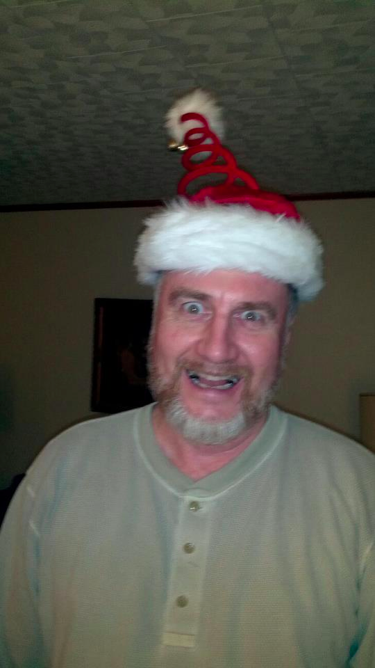
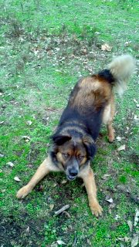
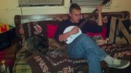
Welcome Back!! First catalyst of 2012 ☺
I hope you had a great Christmas break!
Write me a five sentence paragraph telling me all the great presents you got and all the fun things you did.

Slide 3
Classroom Culture/Survey Feedback : 15 minutes
“Breathe woman breathe!”
More energy in the morning
More group work
Give us study guides earlier
I feel like I can talk to you about anything
Use beach ball more
More experiments

Slide 4
survey responses
Vocabulary games
Ms. Mitchell rocks!
More homework
More hands-on
“I wouldn’t mind if you were a little bit more strict on students who don’t do anything.”
“I will try to do better and act more like a leader”
Stop yelling so much
She makes the best out of a lot of crappy situations

Slide 5
Survey responses
Put the people out who don’t want to pay attention
Stop being so easy on the kids that take advantage of you because you are nice.
She’s the sweetest teacher I got
Slow down the time limits
Phone number
Everyday examples
Games for exit tickets
Lame jokes

Slide 6
Survey responses
I just want to say thanks for helping me with my work and my grades
Better job at controlling the class
Named some kids that are distracting them
“Staying on task while all these immature _______ kids throw stuff, talk, and you know.”
Its not that I wish I was in a different Biology class just that some of the other students were in a different Biology class
Some days we all enjoy the foolishness, but it shouldn’t be an everyday thing.

Slide 7
things we are working on second semester: 10 minutes
A positive classroom environment
Teamwork
Stronger focus on our classroom goals (College-ready!!!)
More rewards for positive behavior; plan for not meeting expectations (Dojo; Consequences)

Slide 8
Jobs This semester…
Chosen from best application—just like a real job!!
Fewer jobs available
Better pay!!
50 bonus points
Free assignment pass (for real)
Employee appreciation party
Future job references
Clearly defined duties

Slide 9
Positions
Paper Manager
Librarian
Student Teacher
Messenger
Technology Manager
Lab Manager
Dojo Manager*
Notes:
Student teacher: stamp catalysts, take attendance, grade catalysts at the end of the week
Technology manager: responsible for changing power point slides, dealing with any technical glitches that may arise, ensuring that speakers are coDojo Manager: would be responsible for entering dojo points into the system. this job would require some work after school.
nfigured when showing videos, cuing up videos, etc.

Slide 10
Unit 5 Questions we will answer
How do organisms inherit traits from their parents?
How do offspring (i.e. children) get certain traits from parents and not others?
How can we use probability to predict what traits offspring will get from their parents?

Slide 11
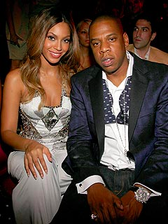
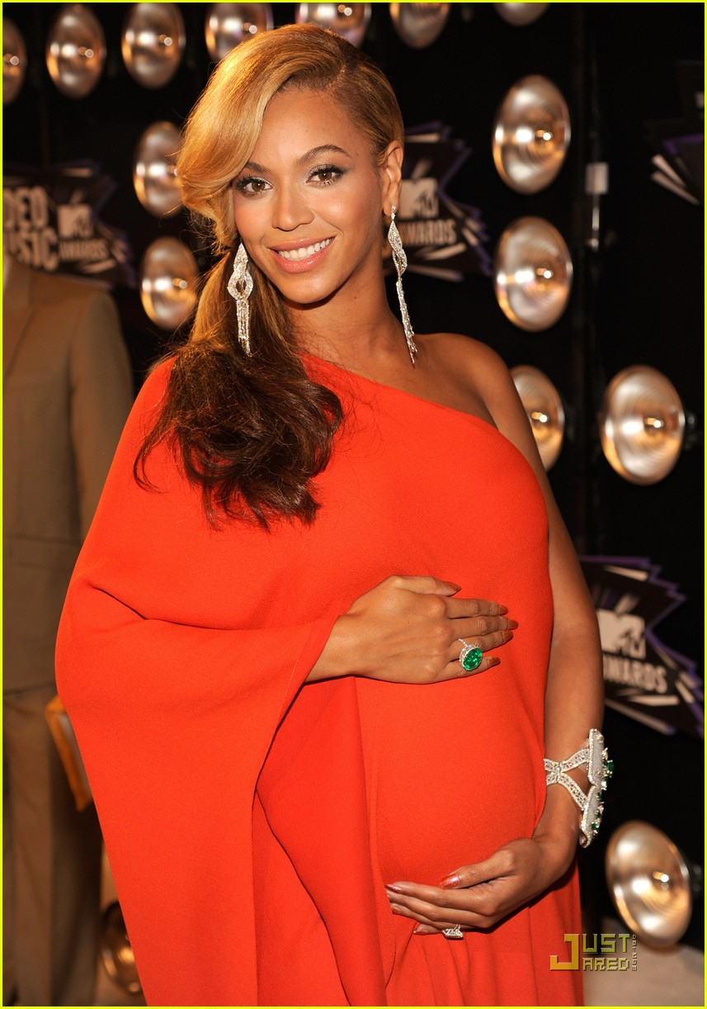
Jay-z and Beyonce’s baby Partner project
BEYONCE
+
JAY-Z

Slide 12
How do you think their baby will look?
You and your partner will…
use the pictures of Jay-Z and Beyoncé to list their physical traits
Predict and list what traits you think the baby will have
Create a picture (drawing, cut out features) of their baby

Slide 13
Exit Ticket: Slap the Door
On your piece of paper, write three goals that you have for our class and/or yourself this semester. When you get the tape, put a piece of tape on the back.
As you walk out the door, slap your ET on the door!

