Slide 1
Catalyst
For the trait of tongue rolling:
R = Can roll r = Can’t roll
a) Which gene is dominant?
b) Which gene is recessive?
c) What would be the heterozygous combination?
d) If someone had the genotype Rr, could they roll their tongue?
e) If someone had the genotype rr, could they roll their tongue?

Slide 2
Announcements
Jobs!
Semester Exam Make-Up
Unit 5 Test next Tuesday
Study guide tomorrow

Slide 3
Big goals
All students will develop, run, and present an original lab study from start to finish.
100% Proficient; 90% Advanced
80% Mastery of EOC and critical thinking questions on all unit exams
At least 5 points of growth on the ACT.

Slide 4
Unit 4 test tracking: 10 minutes
Grade curves
Like always, calculate your percentage mastery based on
Points correct / points total
Watch out! Some sections on the test are not SPIs that need to be tracked.
Tracking Sharing: Why is it important? Does it matter to you?

Slide 5
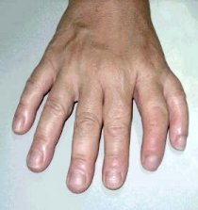
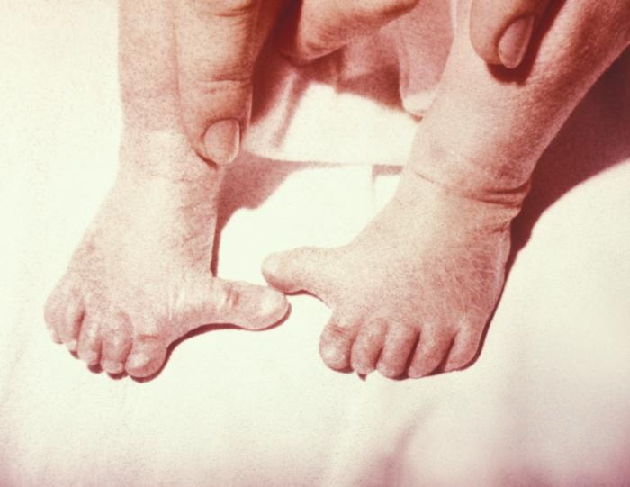
Hook
Which do you think are better or more desirable—dominant genes or recessive genes?
Notes:
polydactyly

Slide 6
Genotype and phenotype: 10 minutes
Short notes today-I promise ☺ (but you shouldn’t be whiny anyways)
Review: homozygous or heterozygous
An organism can be homozygous or heterozygous, but we can’t always tell from their appearance.

Slide 7
Genotype and phenotype cont.
Genotype: an organism’s allele pairs (i.e.: Yy or YY)
Phenotype: outward expression of a gene pair

Slide 8
How do we remember this?
Heterozygous
Homozygous
Phenotype
Genotype

Slide 9
Mendel’s law of segregation
Remember in meiosis how the chromosome pairs are separated?
The gametes formed have half the genetic information.
Mendel’s law of segregation states that two allele pairs separate during meiosis. During fertilization, two alleles for a trait are randomly united.

Slide 10
Pipe Cleaner babies!: 20 minutes
Random partner assignment
2 minutes to get into partner groups
Pick someone to get your assignment sheet and materials
All of your instructions are on your assignment sheet
I will be walking around for help

Slide 11
Expectations
You and your partner will each get a chromosome bag. They are labeled “male” and “female.”
These bags DO NOT correspond to your gender.
This is just a way for us to understand how chromosomes combine and how genotypes are expressed.
If you cannot handle this project with maturity (i.e. complaining, making inappropriate remarks) you will automatically receive a 0 (this is worth 50 points).

Slide 12
partner assignments
1, 34
2, 33
3, 32
4, 30
5, 29
6, 28
7, 27
8, 26
9, 25
10, 24
11, 23
12, 22
13,21
14, 20
15, 19
14, 18
16, 17

Slide 13
Exit Ticket
Is it possible for you to know your genotype for different traits? Why or why not?

