Slide 1
Catalyst
Give two examples of a phenotype and a genotype.
What is a monohybrid cross?
How can you remember the difference?

Slide 2
Announcements
Test make-up? Questions about class?? Fun times with Ms. M?!? TUTORING!!
Study guide due on Tuesday
January prize
If you have a job…
Standard packets will be available next week

Slide 3
Big Goals
All students will develop, run, and present an original lab study.
100% Proficient; 90% Advanced
80% Mastery of all EOC and critical thinking level questions on all unit exams
At least five points of growth on the ACT

Slide 4
Punnett Squares
Yesterday, we learned about Punnett squares. Let’s go over the basics.

Slide 5
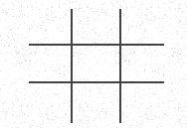
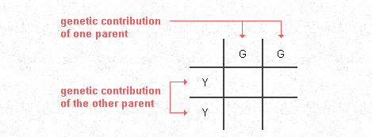
How to draw a Punnett square…
1. Draw a tic tac toe grid.
2. You put the genotype of one parent across the top and the genotype of the parent on the left side.

Slide 6
And then…
Next, all you have to do is fill in the empty boxes by copy the row and column head letters across or down into the empty squares.
This gives us the predicted frequency of all the potential genotypes among the offspring each time reproduction occurs.
In this example, 100% of the offspring will be heterozygous (YG).

Slide 7
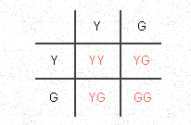
What percentage of the offspring would be YY?
YG?
GG?

Slide 8
Probability Review
Ratios….
Ratios tell how one number is related to another.
In the case of Punnett squares, tells us how many offspring there are compared to another type.
Remember the dihybrid ratio 9:3:3:1
To find the probability of offspring, we simply look at how many of that genotypic combination (i.e. YY) are there out of all the results.
1 of 2 is the same as ________ %
3 of 4 = _______ %
1 of 4 = __________ %

Slide 9
Practice Packets
We are going to be practicing monohybrid and dihybrid crosses.
This will be a mixture of working as a class, working with a partner, and working individually.
Expectations: You will follow along with the class. We will have “show check-ups” where you will have to hold your packet up.
This packet is worth 40 points. It is minus 10 points each time we do a show check-up and you are not on task.
Due on Friday

Slide 10
Spongebob is heterozygous for his squarepants and heterozygous for round eyes. SpongSusie is homozygous for roundpants and homozygous for oval eyes.

