Slide 1
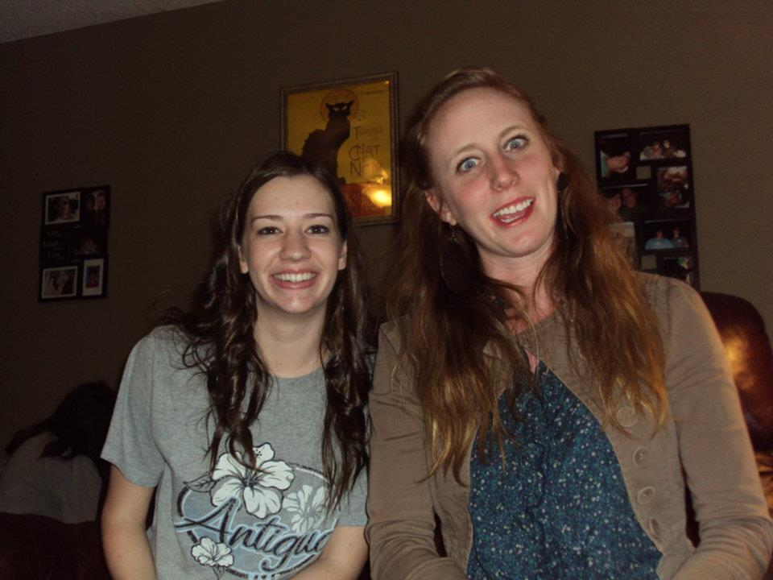
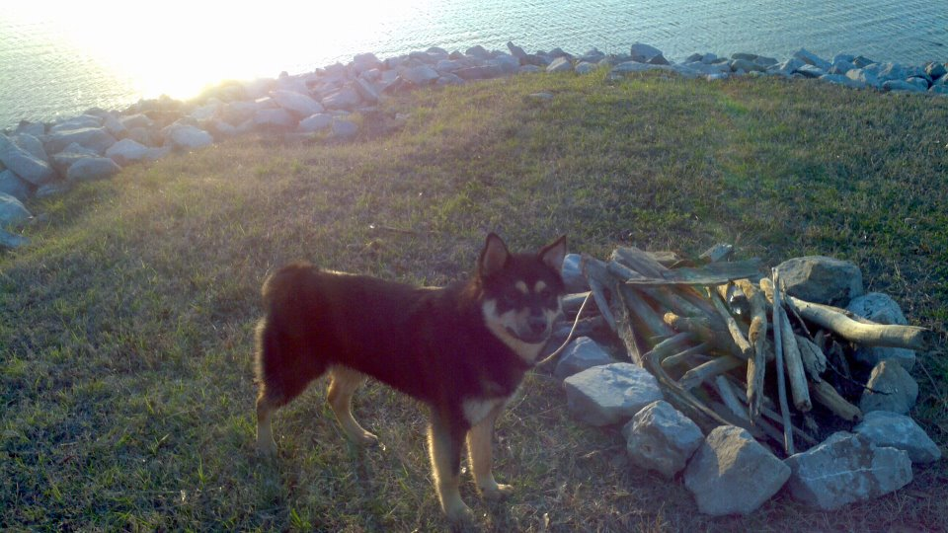
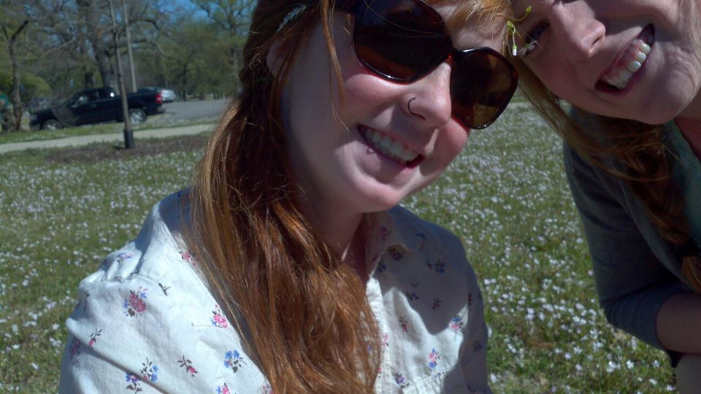
Welcome Back!
Ms. Mitchell’s Spring Break

Slide 2
Announcements
Evolution Unit Review: Due Thursday. (If you were not here Friday before SB, you need to get one).
Review + Unit Test Thursday

Slide 3
Dojo Rewards
Shurrell: fruit punch/hot fries
Terrica: hot fries/hershey
Rosa: starbursts
Jerrica: hot fries
Brandon J.: hot chips
Kameasha: hot fries
Leatha: skittles
**Jazzy and Alisha
**Joshua Mays

Slide 4
White Board Review
Convergent evolution
Divergent evolution
Homologous structures
Analogous structures
Vestigial structures
Adaptations
Natural Selection

Slide 5
White Board Review
Structure that has the same function but did not come from a common ancestor

Slide 6
White Board Review
Organisms that began at the same developmental point, but, over time, develop different characteristics in order to adapt to their different environments

Slide 7
White Board Review
The change of organisms over time

Slide 8
White Board Review
Traits that organisms develop over time in response to an environmental pressure (Ex.: camouflage)

Slide 9
White Board Review
When two unrelated species develop similar traits

Slide 10
White Board Review
A similar structure inherited from a common ancestor

Slide 11
White Board Review
Structures with reduced function

Slide 12
Objectives
SWBAT determine the relatedness of different species based on DNA sequences

Slide 13
DNA Sequencing
Evolutionary theory = states that organisms evolved from a common ancestor
In order to determine how closely related two different species are, scientists can determine relatedness by looking at sequences of their DNA

Slide 14
Dojo Points!
ATGATACGATACC

Slide 15
Example

Slide 16
Practice

Slide 17
More Practice
Species | DNA Sequences
Species 1 | CAA GAC GAT TTA CAC
Species 2 | TAG GGA CAT CCC ATT
Species 3 | CAA GGC AAT TTA CAG
Species 4 | TAG GGA CCT CCA ATT

Slide 18
More Practice
Species | DNA Sequences
Species 1 | CAC GTC GTT GAA TTC
Species 2 | CAC GCA TTG AGG TTG
Species 3 | CAC CCT GCT TCA TTC
Species 4 | CAC GTC GTT GAG TTG

Slide 19
Half sheet of paper
Write your name at the top
On it: Come up with two organisms that differ in one trait
Examples:
Red toad and tan toad
Squirrel with thick coat; squirrel with light coat
Lizard that can run fast; lizard that moves very slow

Slide 20
Now: Pass your paper to your right
Write your name at the bottom of the paper
Read the organisms on the sheet of paper
What two different environments do you think the organisms live in? Write it.
Example: A fast lizard could live in the desert because there is not much cover and so they have to run fast to avoid getting eaten. A slow lizard could live in the jungle, because it could just hide in the trees and wouldn’t have to outrun predators.

