Slide 1
Create the complementary strand for the following: atcgacatggactaattccg CGGCATATTTAGCGGTACCA
Catalyst

Slide 2
ANNOUNCEMENTS
LAST DAY TO MAKE UP UNIT 6 EXAM
QUESTIONS ABOUT PROGRESS REPORT? COME TO TUTORING!
SURVEYS WILL GO OUT TOMORROW.
THEY ARE DUE WEDNESDAY, FEB. 15TH!! QUESTIONS?

Slide 3
MASTERY TRACKING: 5 MINUTES
PUBLIC TRACKING
REVIEW OF WHAT TRACKING MEANS
UNIT 5 MASTERY SUPERSTARS!

Slide 4
DNA VIDEOS/QUIZ: 15 MINUTES
TWO VIDEOS: REVIEW OF DNA STRUCTURE + DNA REPLICATION
http://player.discoveryeducation.com/index.cfm?guidAssetId=9390C23D-D6CF-454C-93C8-BE7E8D6AE60B&blnFromSearch=1&productcode=US
THERE WILL BE A VIDEO QUIZ; YOU CAN USE NOTES ON IT (THE NOTES YOU TAKE DURING THE VIDEO!)
TAKE NOTES DURING THE VIDEOS; YOU CAN USE THE SAME NOTES AS YESTERDAY

Slide 5
VIDEO QUIZ
TRUE OR FALSE. THE GENETIC CODE FOUND IN DNA IS USED IN EVERY LIVING CELL.
DNA IS LOCATED IN THE NUCLUES IN THE SUBSTANCE CALLED ________.
WHAT TYPE OF BOND CONNECTS THE NITROGEN BASES?

Slide 6
VIDEO QUIZ CONTINUED
GENES ARE MADE FROM _____.
GENETIC CODE WORDS ARE HOW MANY LETTERS LONG?
TRUE OR FALSE. PROTEINS ARE INVOLVED IN DNA REPLICATION.

Slide 7
QUIZ QUIZ TRADE: 10 MINUTES
QUESTIONS FROM YESTERDAY
WHISTLE BLOWS: QUIZ PARTNER; WHISTLE BLOWS: QUIZ PARTNER; WHISTLE BLOWS: SWITCH

Slide 8
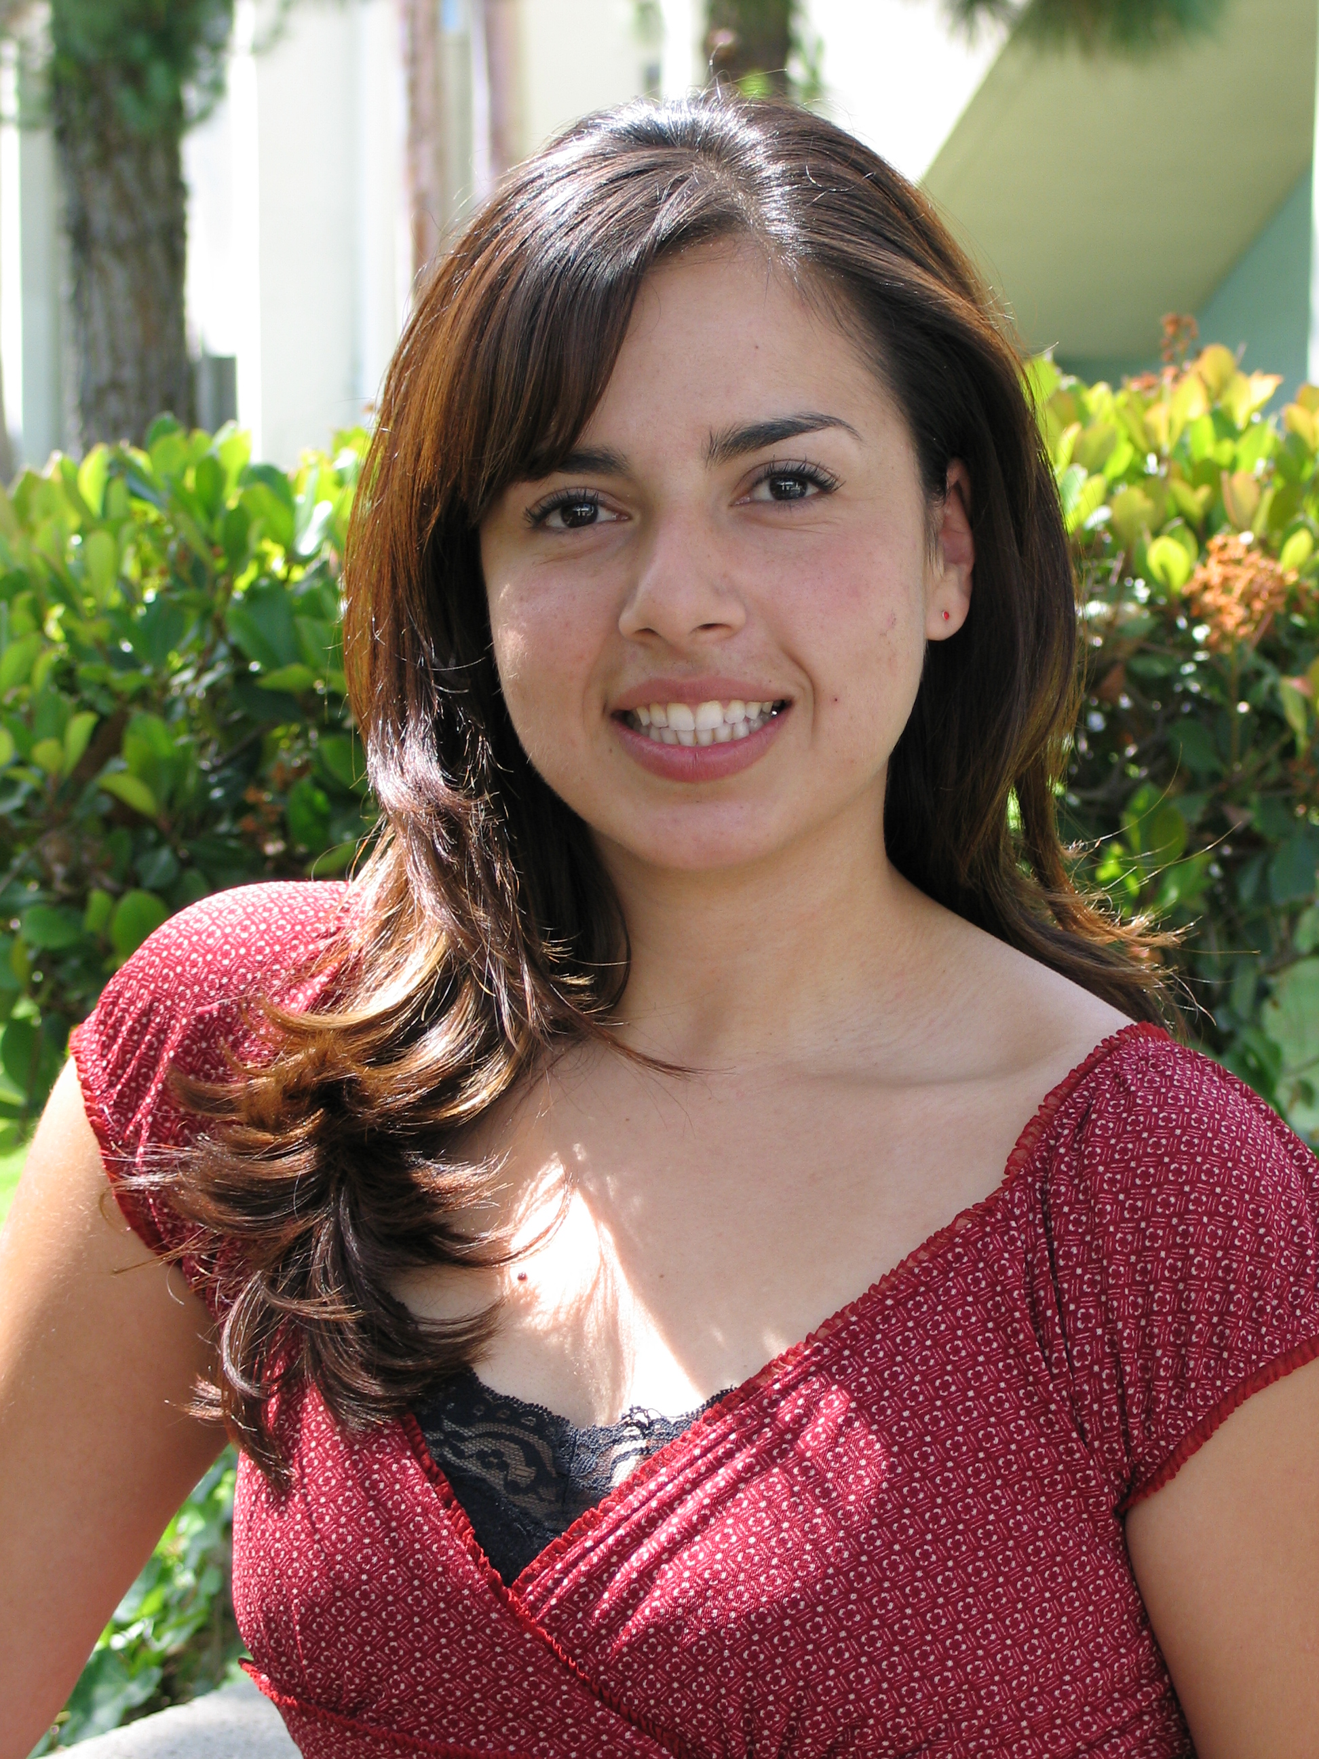
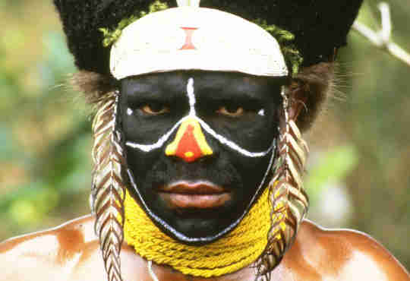
DNA Fun Fact!
Any two unrelated strangers anywhere on the planet share 99.9 percent of the same DNA. A miniscule fraction of the genome—about 3 million of its over 3 billion bases—accounts for the vast differences within the human race.

Slide 9
Objectives
SWBAT compare and contrast the structures and functions of DNA and RNA.
SWBAT define transcription and explain its role in the overall process of protein synthesis.
SWBAT demonstrate transcription by creating the mRNA molecule produced from a given DNA template.

Slide 10
Facts about DNA
How many strands?
Adenine = ?
Uses what sugar?
Used in what process?

Slide 11
How does the cell use DNA to make proteins?
-DNA is used as directions for making proteins.
-DNA cannot leave the nucleus, so in order to make proteins, RNA must be made.
-RNA is much like DNA however it only has one strand and instead of using the nucleotide Thymine (T) it uses the nucleotide Uracil (U). (A=U)
-RNA uses the sugar ribose while DNA uses the sugar deoxyribose.

Slide 12
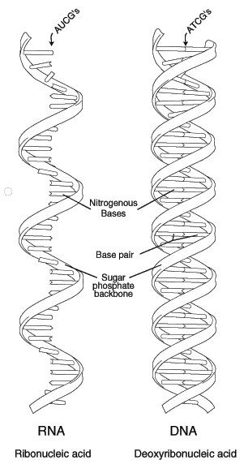
RNA

