Slide 1
Announcements
Tuesday: Unit 5 Test
Make up Unit 6 Test→ Until thisThursday!
Turn in essays

Slide 2
Big goals
All students will develop, run, and present an original lab study.
100% Proficient; 90% Advanced
At least 80% Mastery on all EOC and college level questions on all unit exams.
At least 5 points of growth on the ACT.

Slide 3
DOJO Review: 5 minutes

Slide 4
Friday’s experiment: 7 minutes
What does the term “homologous chromosomes” mean?
If a human gamete with an extra chromosome participates in fertilization with a normal human gamete, what condition results? How many chromosomes will the zygote have?
Many genetic disorders are caused by errors in the genes on our chromosomes. Usually in disorders caused by chromosomal abnormalities, the genes themselves are not mutated; rather, there are too many or too few of them. Why do you think that having too many or too few normal genes creates disorders?

Slide 5
Discovery probe: 20 minutes
Collecting data to see if we are on track to meet our goal of 100% proficiency.
This will cover: Photosynthesis/cellular respiration, Mendelian genetics, and complex modes of inheritance
Remember, this is for a grade, so take your time.
Read the questions carefully. Take your time.

Slide 6
SWBAT analyze the short story, Desiree’s Baby, and its implications about race, skin inheritance, polygenic traits, and genetics.

Slide 7
Desiree’s baby
Introduction to Genetics
Desiree’s Baby is a short story by Kate Chopin.
It investigates issues of race as well as the inheritance of skin color (What kind of trait?)

Slide 8
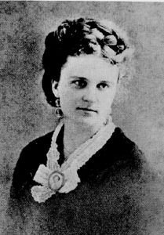
Kate chopin + Desiree’s baby background
Kate Chopin
Characters inhabitants of Louisiana
Addressed race and feminism
Key words: Miscengenation, Quadroon, Mulatto, Polygenetic
Desiree’s Baby:
Focuses on Chopin’s experience with Creoles of Louisiana
Slavery/Plantation life were reality in Louisiana
Someone having a mixed background was not unheard of

Slide 9
Story background
Desiree is a young woman in Louisiana who has just had a baby with her beloved husband, Armand, a plantation owner.
Desiree was found by the side of the road and adopted by the Valmonde family.
Her race of origin is therefore unknown, but she looks white and it has always been assumed that she was white.
Madam Valmonde goes to visit her adopted daughter and when she firsts sees the baby, is surprised and exclaims, “This is not the baby!” Desiree thinks she is talking about how much the child had grown.
*Expectations

Slide 14
Armand sends Desiree and the baby away, despite Desiree’s pleads. Desiree is so distraught, it leads her to take drastic actions

Slide 15
Armand is burning Desiree’s love letter’s, when he finds part of an old letter that his mother had written his father.

Slide 16
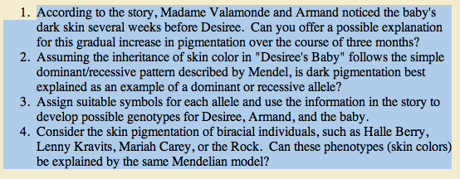
Think-pair-share

