Slide 1
New Catalyst Procedure
In order to prepare for our EOC and reach our goal of 100% Proficiency, we are going to start preparing for the end of course exam NOW.
Each day, you will answer at least five EOC questions. They will either be on handouts or projected on the board.
Each day’s Catalyst will be for a grade.
We will be grading them as a class and going over the correct answers.
In other classrooms, this has doubled teachers’ proficiency rates.

Slide 2
How will we grade?
Grading procedure: We will switch papers and grade each other’s Catalyst. If you are caught cheating (not marking answers wrong, changing answers) YOU AND THE PERSON WHOSE TEST YOU ARE GRADING WILL RECEIVE ZEROS ON THAT DAY’S BELLWORK. This policy will not be altered for anyone or any situation.
I will hand out red pens each class period for you to use while grading. Each day, I will count the number of pens passed out and write that number on the board. When pens are being taken up, you will call out numbers (i.e. 1, 2, 3…) until we reach the number of pens distributed.
Practice!

Slide 3
Announcements
Friday is the last day to turn in any part of your Designer Babies Project. After that THERE WILL BE NO MAKE-UP.
If you were not here for our unit test on Tuesday, you need to come make that up.
WAIM sheet on Friday
Copies of make-up work

Slide 4
Unit 6 Test Tracking
Only two standards: SPI 3210.4.4 and SPI 3210.4.5
First is out of 6; the second is out of 24
How many points you got out of 6/24.
Divide that number; move the decimal over two places.
80% and above = mastery

Slide 5
Objectives
SWBAT identify key events in the history of the Earth using the geologic time scale.
SWBAT define fossil, the fossil record, and describe a sequence of events in fossilization.
SWBAT compare techniques for dating fossils.

Slide 6
Intro
Think about the FIVE most major events in your life. When did it happen? How much time was in between those moments? What were the dates?

Slide 7
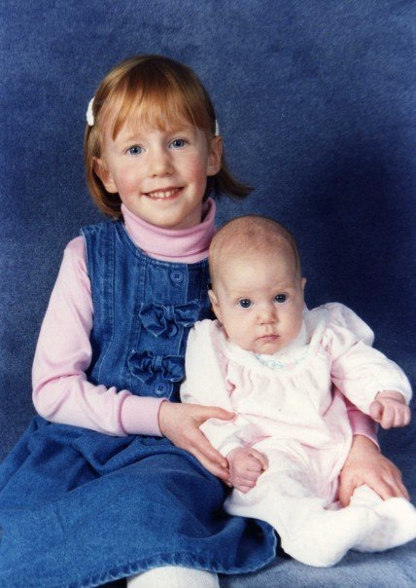
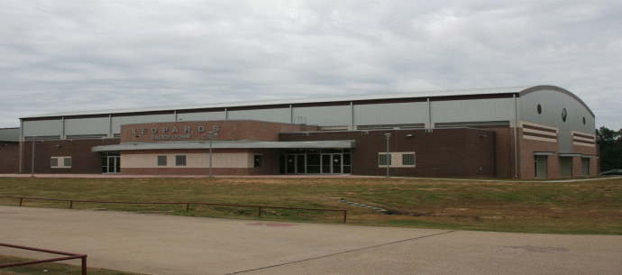
Ms. Mitchell Timeline/Most Important Events
Notes:
Sister is born; Move to Texas, Parents divorce, Attend college at U.T./Graduate, Deciding to be a teacher/moving to Memphis

Slide 8
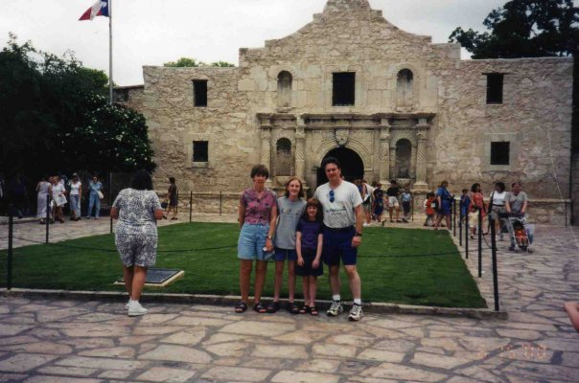
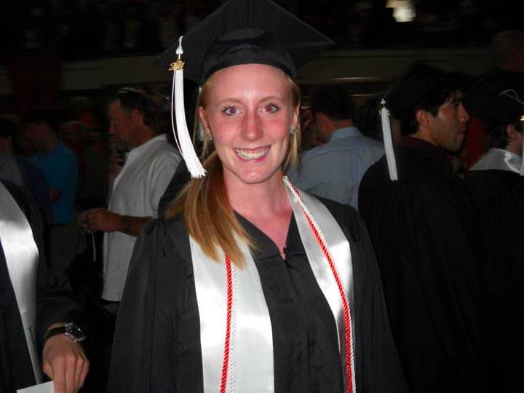
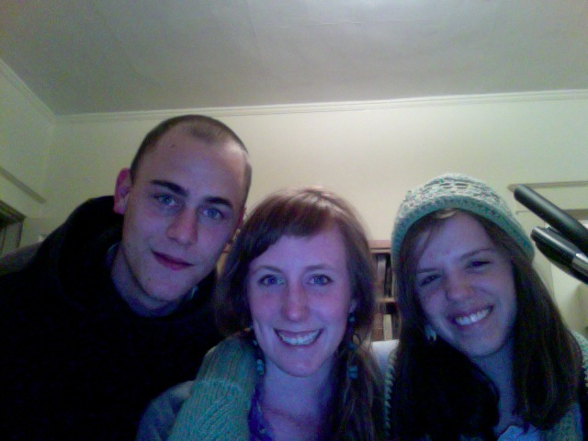

Slide 9
Today, we are going to be talking about Earth’s Timeline.
Think of Earth’s history like a mystery…no one was around to witness it, but there were clues left behind.

Slide 10
Land Environments
By studying other planets, scientists have determined that Earth was a molten body when it formed 4.6 billion years ago.
Earth formed 4.6 billion years ago.
Gravity pulled the densest elements of the planet to the center. After about 500 million years, a solid crust formed on the surface.

Slide 11
Clues in Rocks
Earth cooled to point where liquid water formed on surface → life formed at 500 million years after this
Earliest clues date to about 3.5 billion years ago
A fossil is any preserved evidence of an organism.

Slide 12
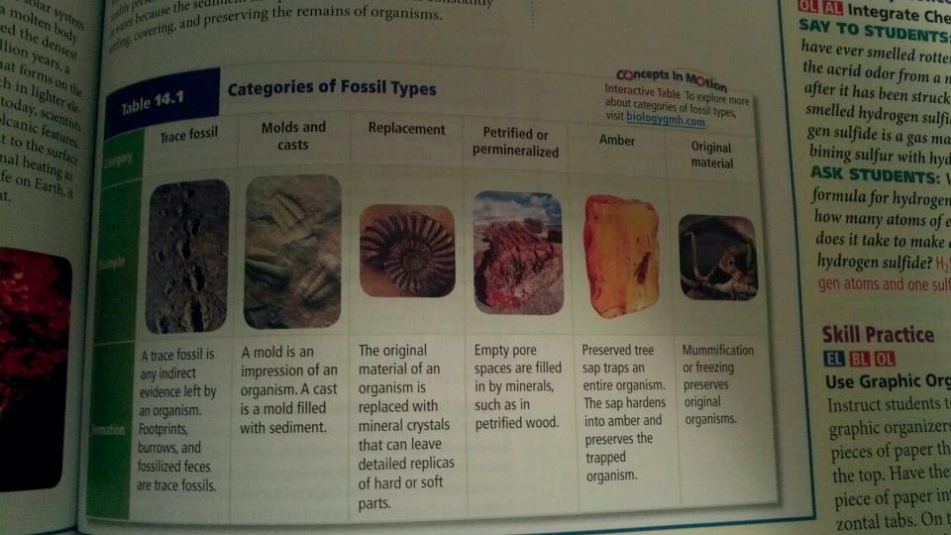
Six Types of Fossils

Slide 13
There is a rich diversity of fossils, but
More than 99% of the species who have ever lived are extinct and we only have a small fraction of those fossils

Slide 14
Fossil Formation
Fossils form in sedimentary rock.
Organisms dies and is buried in sediments (i.e. dirt, soil, etc.).
Sediments build up until they cover organism’s remains.
Minerals may replace organism’s organic matter or organism may die and leave the impression of its body.

Slide 15
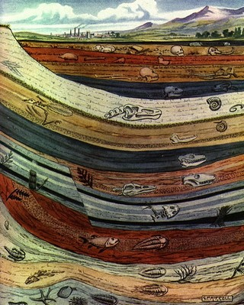
Rock layers of the same age tend to have the same kinds of fossils—no matter the location.
Relative dating: method used to determine age of rocks by comparing them with those in other layers
*Younger layers of rock are on top of older layers

Slide 16
The Geologic Time Scale
Record of Earth’s history
All major events in Earth’s history are on the time scale
Millions of years ago = mya

Slide 17
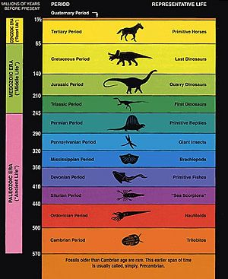
Epochs: smallest unit of time lasting several millions of years
Periods: divisions of time lasting tens of millions of years
Era: unit lasting two or more periods; hundreds of millions of years

Slide 18
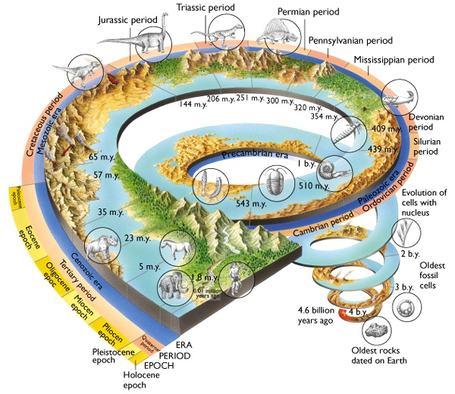

Slide 19
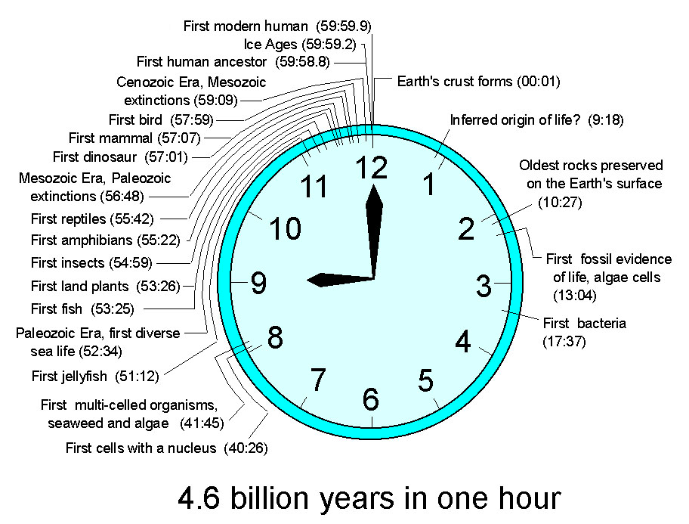

Slide 20
Geological Time Scale Football Field
We are going to be creating the Geological Time Scale on a football field.
On end zone = before Earth
Other end zone = Present
Yards are labeled for you. (but numbering in increasing order may help)
You are given a table of geologic events.
1 yard = 50 million years ago
Divide millions by 50 and it will give you the yards. Round to the nearest number.
To convert billions to millions, add two zeros to the end. Ex. 1.2 billion = 1200 million
Practice as a class

Slide 21
Partner Work
You may work with a partner or by yourself.
You will be turning this in at the end of the class!!
If you and your partner cannot work efficiently and quietly, you will receive a zero!
Read the instructions OUT LOUD before asking me for help. (I will make you read them out loud!!!)

