Slide 1
Announcements
Visual turn-in!
If you don’t have it today, you can still bring it! ☺
Physical visuals: please bring them to the back
Electronic visuals: Make sure that you have either emailed it to me OR flash-drive!
DISCOVERY TESTING!!!

Slide 2
Objectives
SWBAT identify specific examples of modern genetic technologies and their various applications.
SWBAT evaluate the pros and cons of various genetic technologies covered in class.

Slide 3
You are not the father!
Maury Clip

Slide 4
What is Biotechnology?
The use of living organisms or their products to modify (change) human health or the environment.
Examples: stem cell research

Slide 5
Four Major Kinds
DNA Fingerprinting
Paternity Testing
Transgenic Organisms
Stem Cell research
Vote: Which have you heard of?

Slide 6
DNA Fingerprinting
Review: T or F. Organisms may or may not have identical DNA.
A test used to identify the genetic information in a person’s cells
Called a “fingerprint” because it is very unlikely that two people share the same DNA, just like fingerprints!
Only a small sample of cells is needed: a drop of blood, hair, body fluids

Slide 7
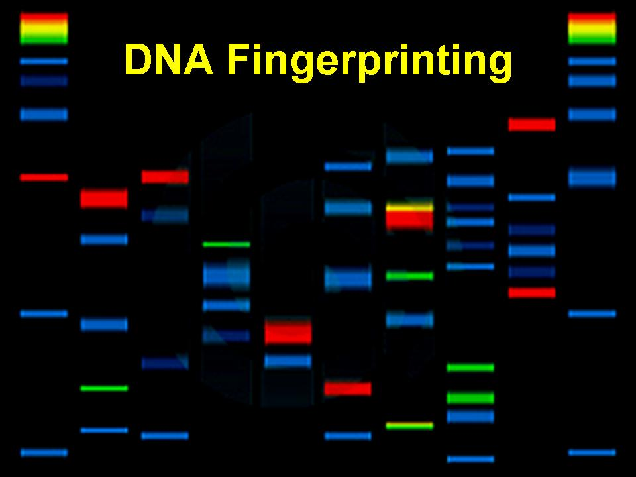
DNA Fingerprinting Cont.
Used for:
Determining who a person’s parents or siblings are
Solving crimes (Presence at a crime scene)
Identifying a body

Slide 8
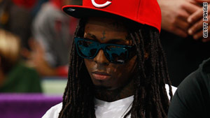
Paternity Testing
Uses DNA fingerprinting to determine if two people have a biological parent-child relationship
It can establish parentage (being a parent) at a probability of 99% or higher
“Paternal” = father
“Maternal” = mother
Do-It-Yourself Paternity kits
Famous cases?
Anna Nicole Smith, Lil Wayne paternity suit (2010),

Slide 9
Transgenic Organisms
A transgenic organism is a type of genetically modified organism that has genetic material (i.e. DNA) from another species that provides a useful trait. (Pro)
Example: Animal modified genes to secrete a human protein

Slide 10
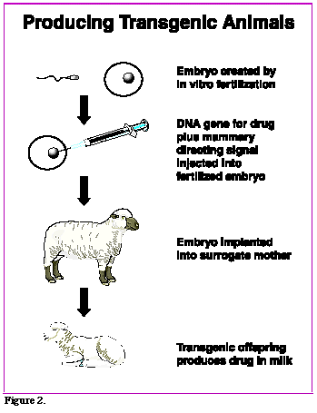

Slide 11
Transgenics/Ethics cont.
Ethics: What is ethics?
Impact of science on society and individuals; “greater good” vs. negative effects
Trangenics: Ethical? (cons)
Interfering with another organism
“Unnatural”
Damaging ecosystems

Slide 12
Stem Cell Research
You are an average citizen and you pass a fertility clinic and discover it is on fire. You run into the building to ensure no one is left inside. There is a baby crying in one room and a tank full of 20 embryos. Which do you save and why? Note: You can only save one and you MUST choose to save one.

Slide 13
Stem Cell Research
What: Stem cells are cells found in most, if not all, multi-cellular organisms. They are special because they can renew themselves through dividing and differentiating (specializing) into a diverse range of specialized cell types.
Why: Adult stem cell treatments have been successfully used for many years to treat leukemia and related bone/blood cancers through bone marrow transplants. (PRO) The use of adult stem cells in research and therapy is not as controversial as embryonic stem cells, because the production of adult stem cells does not require the destruction of an embryo. (CON)

Slide 14
PRO: Adult stem cells used to treat leukemia/blood cancers.
CON: Embryonic stem cells requires the destruction of an embryo.

Slide 15
Ethical Issue
Is the destruction of a single embryo justified if it provides a cure for a countless number of patients?

Slide 16
CFU
What is one advantage of stem cell research?
What is one ethical concern about transgenic organisms?
What is a transgenic organism?
What is a DNA “fingerprint’?
What are ethics?
What is a stem cell?
How do you feel about stem cell research?

Slide 17
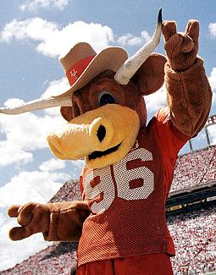
Murder in Biology Class!
The Facts: Friday morning, the mascot for Ms. Mitchell’s University (University of Texas), Bevo, was found dead. Cause of death has not yet been determined although Bevo was surrounded in vomit and was purple. Some biology notes were found at the scene of the crime as well as one finger print and a piece of hair. All students in Ms. Mitchell’s class are suspects, and she needs your help to try and find out who the murderer is!!!

Slide 18
The Crime Scene
In order to figure out who did it, we need to think like the murderer. As you look around the room, think of poor Bevo ☹ and think about the facts of the case. Then answer the questions below:
When did Bevo die?
How do you think Bevo was killed?
Why do you think Bevo was killed?

Slide 19
THE DNA SAMPLE
The DNA Sample: Developed in England in 1985, DNA fingerprinting is the process of figuring out the order of nucleotides in a person’s DNA. Every person has unique or different DNA, so when detectives find a piece of hair, or skin or blood at a crime scene, they take it to a laboratory where scientists can try to match the nucleotide pattern (A, T, G and C) with suspect’s DNA.

Slide 20
The Clues
Biology notes-must be a student!
A hair-we can take DNA out of the hair and try to find a match in this class!

Slide 21
ATG CAA TTA GCC ATC
You each have a DNA sample
If the first sequence (purple) is different sit down.
If your second sequence (green) is different, sit down.
If your third sequence (red) is different, sit down
If your fourth sequence (blue) is different, sit down

Slide 22
What is DNA fingerprinting?
Why do you think DNA fingerprinting helps detectives solve murders better than fingerprints?
What evidence do you have that that person is the murderer? (Does their DNA match?)

Slide 23
Exit Ticket
List one of the four genetic technologies that we talked about today or yesterday(DNA fingerprinting, Paternity testing, transgenic organisms, stem cell research, or cloning) and what it is used for.
Genetic technology:
Use:
List one pro and one con of embryonic stem cell research OR transgenic organisms.

