Slide 1
Catalyst
Literacy:
1. What are the three components that make up a nucleotide?
2. What are the three steps of protein synthesis?
Numeracy:
3. What is a codon? What is an anti-codon?

Slide 2
ANNOUNCEMENTS
TUTORING TODAY
ESSAYS
Absences
Academic Dishonesty

Slide 3
HOMEWORK TURN-IN
QUESTIONS FROM HOMEWORK?
AMINO ACID CHART FROM HOMEWORK

Slide 4
Objectives
SWBAT DEFINE MUTATION AND IDENTIFY CAUSES OF MUTATIONS.
SWBAT COMPARE AND CONTRAST POINT MUTATIONS, FRAMESHIFT MUTATION, AND SOMATIC AND SEX CELL MUTATIONS.
SWBAT EXPLAIN THE RELATIONSHIPS BETWEEN MUTATIONS AND GENETIC DISORDERS AND IDENTIFY DISORDERS CAUSED BY MUTATIONS.

Slide 5
HOOK
Have you ever made a typo on a paper? Sign? We know Ms. Mitchell has…

Slide 6
Mutations
Sometimes cells make mistakes during replication.
-A mutation is a change in DNA sequence (order of nucleotides).
-Mutations are important because they increase genetic variation.

Slide 7
Mutations can range from changes in a single base pair in the coding sequence of DNA (i.e. G = C) to the deletions of large pieces of chromosomes.

Slide 8
There are several types of mutations…

Slide 9
1. Point mutation
-Point mutation-a change in one base pair in a DNA sequence.
-A point mutation can cause an amino acid to change, which will change the structure of the protein being made.
Example: AUG=Met
AAG=Lys
-Only one letter was changed (the A to a U) and the entire amino acid changed (from methionine to lysine).
This is enough to cause a genetic disorder!

Slide 10
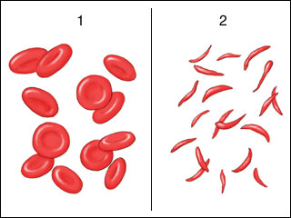
Point mutations in our lives!
-Sickle cell anemia is a blood disease caused by a point mutation.
-A single nucleotide is changed from “A” to “T” which causes the amino acid to change from glutamic acid to valine:
Amino acids: Thr – Pro – Glu – Glu
Normal: ACT CCT GAG GAG
Sickle cell: ACT CCT GTG GAG
Amino acids: Thr – Pro – Val – Glu

Slide 11
2. Frameshift mutation
-Frameshift mutation-adding or deleting nucleotides to a DNA sequence.
Two types:
Insertion: addition of a nucleotide
Deletion: loss of nucleotide
*Happen in multiples of three, from point of insertion to deletion
-A frameshift mutation is much worse than a point mutation because it causes the entire DNA sequence to be shifted over!
Example: DNA: ATTAAACCG
ATAAACCG
Delete this T

Slide 12
V. Frameshift mutation
Deletion of U
Frameshift mutation
mRNA
Protein

Slide 13
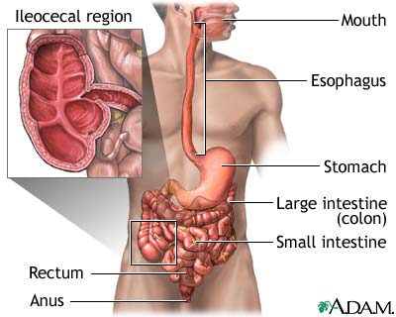
Frameshift Mutations
Crohn’s Disease is caused by a frameshift mutation.
It causes inflammation to the digestive tract.

Slide 14
Difference between a point mutation and a frameshift mutation.

Slide 15
Question:
Is this a point mutation or a frameshift mutation?
-It’s a point mutation because only one nucleotide changed!

Slide 16
QUESTION
WHAT TYPE OF MUTATION? (POINT OR FRAMESHIFT)
GAC TAC GAA → GAC TCC GAA
AGA TCC GAG → AAT CCG AG
TAT GAC CCA → TAT GTA CCC A
CAC TAG AAT → CAC TGG AAT

Slide 17
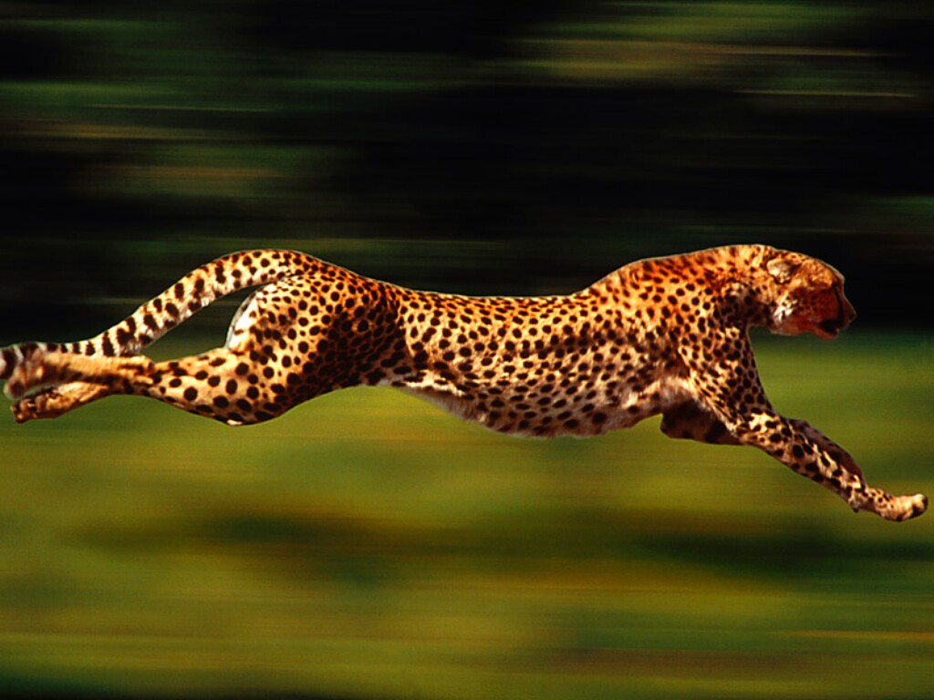
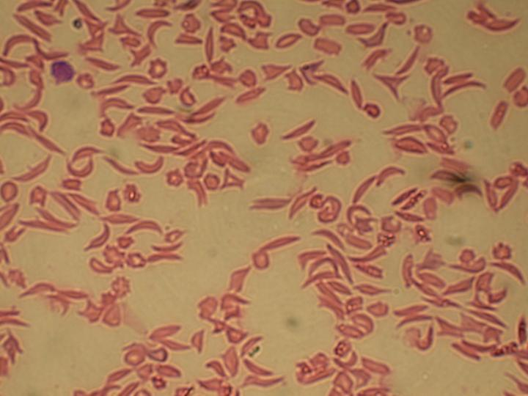
Good vs. Bad Mutations
Mutations can be good as well as bad. A good mutation could lead to a change in a protein that allows an animal to run faster or see better. A bad mutation could lead to a change in a protein that causes a genetic disease such as Sickle Cell Anemia or Hemophilia.

Slide 18
CAUSES OF MUTATIONS
Some, like, point mutations can occur spontaneously.
Another cause is mutagens..

Slide 19
Mutagens
A mutagen is something that causes a mutation.
Ex: radiation, chemicals, high temp.These can change the structure of the bases, resemble nucleotides and replace them.
Radiation can cause a structure disruption that keeps DNA from replicating.

Slide 20
Mutations in Body Cells
-Mutations in somatic cells that are not repaired will be passed down to future daughter cells.
However, mutations in body cells cannot be passed on to your children. They can cause cancer or other problems in your body.
Mutation → abnormal protein → cell not performing normal function
A cancer cell.

Slide 21
Cancer as a result of mutations in body cells:
A person with skin cancer-This is why it’s important to always wear sunscreen!

Slide 22
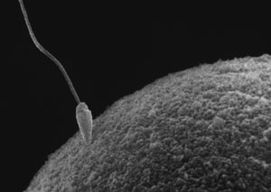
Mutations in Reproductive (Sex) Cells
-Mutations in sex cells (sperm and egg cells) can lead to changes in the DNA sequence which will be present in the organism’s offsprings’ cells.
Abnormal protein in sex cell → offspring is impacted

Slide 23
DNA MUTATION ACTIVITY
Work with a partner
We will read the instructions as a class.
BEFORE YOU ASK FOR HELP, READ THE INSTRUCTIONS OUT LOUD. I will make you read the instructions out loud if I come help you.

Slide 24
DNA MUTATION ACTIVITY
Write the tRNA and amino acids on your own sheet of paper!

Slide 25
Exit Ticket
List the type of mutation shown in each example below:
CCC GAT TCA → CCC CAT TCA
ATT GCA ACT → ATA TGC AAC T

