Slide 1
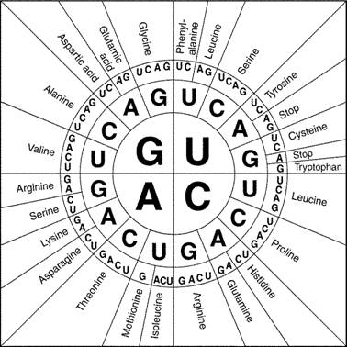
CATALYST
Complete the table below.
DNA: GCTACATTG
mRNA
Amino Acids

Slide 2
Announcements
Surveys due!
Homework due tomorrow
Quiz today

Slide 3
Survey Discussion
Compare and contrast averages
Class average:
Class Data Posters
How can you use this data to inform your opinion and create your visual?
Next step: visual

Slide 4
Visual Rubric
Visual component is a power point, poster, collage, or blog.
_ Visual component is complete (summary, data, and opinion portions) and is neat and organized.
_Oral presentation consists of a description of the article’s topic, your opinion on the topic, survey data, and visual component.
_ Oral presentation is at least 4 minutes.
_Oral presentation is well-rehearsed (meaning that you may not look at your notes for more than 15 seconds at a time) and presented with minimal pauses, no poor grammar, and at an appropriate volume.

Slide 5
Transcription and Translation Quiz : 25 MINUTES
NO TALKING
DO YOUR OWN WORK
THERE IS EXTRA CREDIT!!!
WHEN YOU FINISH, PLACE YOUR QUIZ ON THE BACK BOOKSHELF!
YOU WILL NEED A CODON CHART FOR SOME QUESTIONS ON YOUR QUIZ. IT IS ON THE BACK OF YOUR QUIZ!
YOU MAY USE YOUR HOMEWORK FOR 10 MINUTES; NO OTHER NOTES

Slide 6
Codon Chart

Slide 7
HOMEWORK WORK TIME

Slide 8
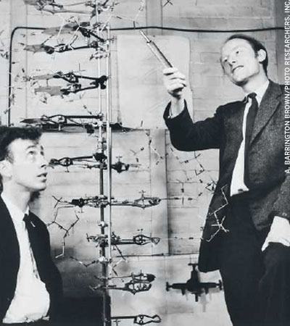
James Watson and Francis Crick
http://www.ted.com/talks/lang/en/james_watson_on_how_he_discovered_dna.html

