Slide 1
Catalyst
Which statement best describes the primary function of DNA replication?
A. to ensure daughter cells have a complete copy of all of the DNA
B. to prevent mutations from occuring in cells
C. to provide genetic variation within specific organisms
D. to allow prokaryotic cells to undergo meiosis

Slide 2
Announcements
First period: mean, median, and mode
Survey due on Wednesday

Slide 3
Discovery Probe
20 minutes
Topics:

Slide 4
DNA Review
-DNA is what contains all the information for making our bodies.
-All cells need DNA, so DNA replicates by splitting apart at the nitrogen bases and making a copy of itself

Slide 5
Questions:
What is DNA?
-DNA is the directions for making proteins in our bodies.
Where is DNA located?
-in the nucleus.
Can DNA leave the nucleus?
-no!
In the first step of DNA replication, the hydrogen bonds break. Where do the two DNA strands separate from each other?
a) between the phosphates
b) between the phosphates and the sugar
c) between the sugars and the nitrogen bases
d) between the nitrogen bases
Answer: D-between the nitrogen bases!
At what stage of the cell cycle does DNA replication happen?

Slide 6
DNA Review:
-DNA never leaves the nucleus of the cell. If this is true, then how does the rest of the cell get information from the DNA?
Because DNA never leaves the nucleus, the cell copies DNA into a different form called RNA (in transcription) which can leave the nucleus. The RNA code is then “read” and turned into proteins in the cytoplasm of the cell (in translation).

Slide 7
Objectives
SWBAT define codon and describe the role of mRNA codons in protein synthesis.
SWBAT define anti-codon and describe the role of tRNA anti-codons.
SWBAT translate a strand of mRNA into the correct amino acid sequence based on the codons present.

Slide 8
Replication vs. Translation
Come up with the complementary mRNA strand based on this DNA strand:
ATGCTTATAGCTAT

Slide 9
Hook
A news broadcast in 28 languages

Slide 10
Summary of Transcription and Translation
-Transcription is when the cell makes a mRNA copy of a DNA strand.
-After transcription, mRNA leaves the nucleus and attaches to the ribosomes on the Rough E.R.
-Translation is the process of turning mRNA into an amino acid chain which can fold up to become a protein. With the help of ribosomes and tRNA, this happens on the Rough E.R.

Slide 11
Protein Structure
Proteins are made out of 20 different kinds of amino acids which a set of 3 mRNA nitrogen bases code for.
The 3 nitrogen base code in DNA and mRNA is called a codon.

Slide 12
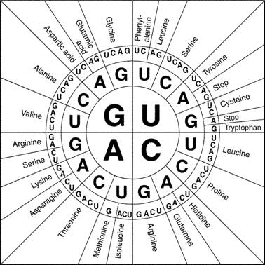

Slide 13
What happens in translation?
-mRNA molecules leave the nucleus and attach to ribosomes on the rough E.R.
-tRNA molecules bring amino acids to the ribosome and then the tRNA molecules match up with codons on the mRNA and form amino acid chains.
-The end result of translation are amino acid chains which fold up to become proteins.

Slide 14
What is tRNA?
tRNA is transfer RNA.
In translation, they act as the interpreters of a mRNA codon sequence.
So, they interpret the codon into amino acids!
tRNA is folded in a cloverleaf shape. At its base, there is a three base code called an anticodon. Each anticodon is complementary (or goes with) a codon on the mRNA.
Each tRNA carries a specific amino acid.

Slide 15
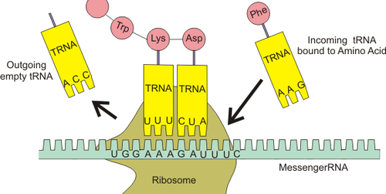

Slide 16
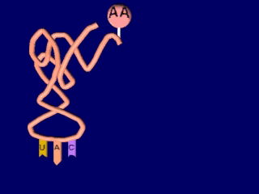
Where does translation happen?
-Translation happens on the ribosomes attached to the Rough E.R.

Slide 17
Practice with translating mRNA to amino acids.
mRNA: AUG GAC AAC GCU
mRNA: AUG GGA CAC AUU
mRNA: AUGGCAUGA

Slide 18
rRNA
rRNA associates with proteins to form ribosomes in the cytoplasm.

Slide 19
Summary:
DNA Replication-1 DNA to 2 DNA (happens in nucleus).
Transcription-DNA to mRNA (in nucleus)
Translation-mRNA to amino acid (A.A.) chain which becomes a protein (on ribosomes in cytoplasm.

Slide 20
Questions:
What happens in transcription?
-a copy of mRNA is made from DNA.
Where does transcription happen?
-in the nucleus.
What happens in translation?
-the mRNA is turned into an amino acid chain which folds up to become a protein.

Slide 21
Questions:
Which of these processes does NOT use DNA?
a. DNA Replication
b. Transcription
c. Translation
Answer-Translation (from mRNA to protein)
Is mRNA made in transcription or translation?
-transcription
Is tRNA used in transcription or translation?
-translation

Slide 22
Catalyst

Slide 23
Transcription and Translation Activity
http://learn.genetics.utah.edu/content/begin/dna/transcribe/

Slide 24
Snork Partner Activity
Introduction: In this simulation, you will examine the DNA sequence of a fictitious organism: the Snork. Snorks were discovered on the planet Dee Enae in a distant solar system. Snorks only have one chromosome with 6 genes on it. You job is to analyze the genes of its DNA and determine what traits the organism has.

Slide 25
Transcription and Translation Practice
Due Thursday!!
(However, you do have a quiz on Replication, Translation, and Transcription tomorrow)

