Slide 1
Catalyst: CELLULAR RESPIRATION QUIZ : November 8th, 2012: 1st-3rd periods
Expectations
When you finish…
Silently.
By yourself.
In your seat.
Turn your quiz over.

Slide 2
Today’s Agenda
Catalyst/Quiz: 5 minutes
Test Scores: 5 minutes
Finish Case Study 10 minutes
Cellular Respiration vs. Photosynthesis Graphic Organizer: 10 minutes
Partner Manipulatives: 15 minutes
Knockout!: Remainder
Homework:
Unit 3 Study Guide
Study for Unit 3 Exam

Slide 3
Reminders
Office Hours today
Dojo Review
WEBSITE : www.msmitchellbio.weebly.com

Slide 4
Unit 3: Guiding Questions
How do plants make food for themselves?
Why do all organisms need some source of food?
Why do we and most other organisms need oxygen?

Slide 5
Today’s SPI & Objectives
SPI 3210.3.3 Compare and contrast photosynthesis and cellular respiration in terms of energy transformation.
SWBAT compare and contrast photosynthesis and cellular respiration in terms of reactants, products, and energy transformation
SWBAT explain the relationship (interdependence) between photosynthesis and cellular respiration

Slide 6
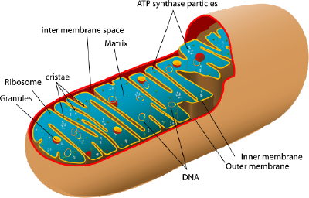
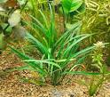
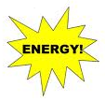
Photosynthesis vs. Cellular Respiration
Biology
Unit 4
Lesson 9

Slide 7
Energy
Remember, all living organisms, and therefore all cells, need energy to survive
Photosynthesis and cellular respiration both address the energy needs of cells
Today we will compare and contrast these two cellular processes

Slide 8
Purpose
Key Point 1: Photosynthesis and cellular respiration have different, but related purposes
The purpose of photosynthesis is to transform energy into food (glucose) for plant cells
The purpose of cellular respiration is to transform food (glucose) into energy for all cells

Slide 9
Location
Key Point 2: Photosynthesis and cellular respiration occur in different parts of the cell
Photosynthesis occurs in the chloroplasts of plant cells
Cellular respiration begins in the cytoplasm but mainly occurs in the mitochondria of all cells
Anaerobic= cytoplasm; aerobic= mitochondria

Slide 10
Chemical Equation
Key Point 3: The chemical equation for photosynthesis is the reverse of the equation for cellular respiration
Photosynthesis:
6 CO₂ + 6 H₂O → C₆H₁₂O₆ + 6 O₂
Cellular respiration:
C₆H₁₂O₆ + 6 O₂ → 6 CO₂ + 6 H₂O (+36 ATP)

Slide 11
Reactants and Products
Key Point 4: The reactants of photosynthesis are the products of cellular respiration, and vice versa
Photosynthesis
Reactants= carbon dioxide and water; products= glucose and oxygen
Cellular respiration
Reactants= glucose and oxygen; products= carbon dioxide and water

Slide 12
Energy Transformation
Key Point 5: Photosynthesis and cellular respiration are different in terms of the energy transformation that they involve
Photosynthesis transforms solar energy into chemical energy
Cellular respiration transforms the chemical energy in glucose into chemical energy in ATP

Slide 13
Interdependence
This is why plants and animals/humans need each other (interdependence)
Animals and humans need oxygen and glucose from plants so they can produce energy
Plants need carbon dioxide from animals and humans so they can produce food

Slide 14
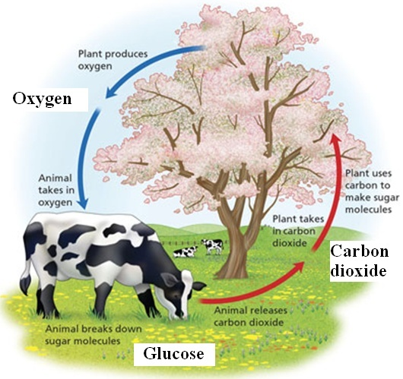
Interdependence

Slide 15
Cellular Energy Cards
You may work with a partner OR independently.
Sort the cards into 2 columns—1 for Photosynthesis and 1 for Cellular Respiration (No gluing!)
Check your cards with Ms. Mitchell when you are finished

Slide 16
Knock Out
Rules!
All partners stand.
Go around the room. The first pair answers a question. Right = keep standing. Wrong = sit
Second pair. Right = First pair has to SIT down; second pair gets to stay standing; wrong = sit down; first pair gets to keep standing
Prize!

Slide 17
Exit Ticket
Answer the questions on the back of your warm-up slip without using any notes
What two reactants do plant cells need for photosynthesis?
What is the purpose of photosynthesis?
What process has the equation below?
C₆H₁₂O₆ + 6 O₂ → 6 CO₂ + 6 H₂O (+36 ATP)

