Slide 1
Catalyst #9 or 10: November 6th (5 minutes) → COMPLETE SENTENCES
What does aerobic mean?
In what part of the cell does aerobic respiration occur?
What gas is produced and released by cells during the Krebs cycle?
How many ATP are produced during the electron transport chain?

Slide 2
Agenda
Catalyst (5 minutes)
WORD WHACK (5 minutes)
Cellular Respiration Review and Concept Map (15 minutes)
Case Study (20 minutes)
Homework:
Study for Cellular Respiration quiz
Review sections 8.2 and 8.3 in book

Slide 3
Reminders
Office hours today: Canceled
Cellular respiration quiz: TOMORROW
Dojo Review tomorrow
Unit 3 Study Guide

Slide 4
Unit 3: Guiding Questions
How do plants make food for themselves?
Why do all organisms need some source of food?
Why do we and most other organisms need oxygen?

Slide 5
Today’s SPI & Objectives
SPI 3210.3.2 Distinguish between aerobic and anaerobic respiration.
SWBAT summarize the overall process of aerobic respiration in terms of its location and products
SWBAT analyze a real world cellular respiration case study.

Slide 6
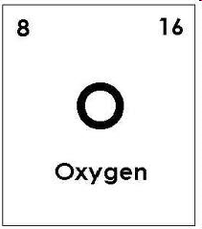
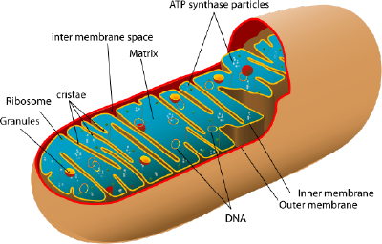
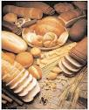
Cellular Respiration Review
Biology
Unit 3
Lesson 8

Slide 7
WORD WHACK: Cellular Respiration Review
Review of rules
Expectations for participants at the board
Expectations for whole class
How to participate

Slide 8
WORD WHACK
Cellular Respiration
Anaerobic respiration
Aerobic Respiration
Mitochondria
Glycolysis
ATP
Krebs Cycle
Lactic Acid Fermentation
Electron Transport Chain

Slide 9
Concept Map
Expectations
Structure: Us + You

Slide 10
Word Bank (each word only used once)
2 ATP 2 ATP 32 ATP 8 NADH 2 FADH₂ Electron transport chain Mitochondria
Cytoplasm Fermentation Glycolysis Glucose Pyruvate Lactic acid Krebs Cycle

Slide 11
Word Bank (each word only used once)
2 ATP 2 ATP 32 ATP 8 NADH 2 FADH₂ Electron transport chain Mitochondria
Cytoplasm Fermentation Glycolysis Glucose Pyruvate Lactic acid Krebs Cycle

Slide 12
Cellular Respiration Concept Map
What reactant is needed to begin cellular respiration?
Glucose
During what stage of cellular respiration is glucose broken down?
Glycolysis
How many ATP are produced during glycolysis?
2 ATP
In what part of the cell does glycolysis occur?
Cytoplasm

Slide 13
Cellular Respiration Concept Map
Is glycolysis considered aerobic or anaerobic respiration?
Anaerobic respiration
What is not required for anaerobic respiration to occur?
Oxygen
What product of glycolysis is used during aerobic respiration (Krebs cycle and electron transport chain)?
Pyruvate

Slide 14
Cellular Respiration Concept Map
What is the name of the process that pyruvate is used in when oxygen is not present (anaerobic) after glycolysis?
Fermentation
What is produced during fermentation?
Lactic acid

Slide 15
Cellular Respiration Concept Map
What stage comes after glycolysis and begins aerobic respiration?
Krebs cycle
In what part of the cell does the Krebs cycle occur?
Mitochondria
What gas is produced by cells during the Krebs cycle?
CO2 (carbon dioxide)

Slide 16
Cellular Respiration Concept Map
How many ATP are produced during the Krebs cycle?
2 ATP
What two electron carriers are produced in the Krebs cycle and used in the final stage of cellular respiration?
8 NADH and 2 FADH2

Slide 17
Cellular Respiration Concept Map
What is the third and final stage of cellular respiration?
Electron transport chain
What product of cellular respiration is formed during the electron transport chain?
Water (H2O)
How many ATP are produced during the electron transport chain?
32 ATP

Slide 18
CFU: Agree/Disagree
Oxygen is the reactant broken down in glycolysis. A/D
The Krebs Cycle occurs in the mitochondria.
The electron transport chain produces 36 ATP.
Cellular respiration converts chemical energy to solar energy.

Slide 19
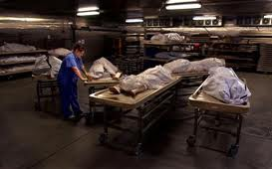
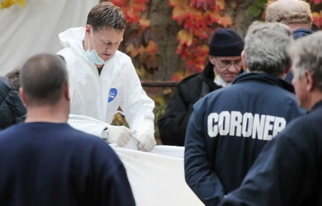
Cellular Respiration Case Study
Some vocabulary: case study, cyanide, coroner
Intro to case study
Partner work expectations

Slide 20
Steps
1. Read through Part 1 entirely. This can be done silently, read-aloud, or popcorn reading.
2. Answer the questions for Part 1. Remember, each partner will turn in answers. Make sure your answers are in complete sentences.
3. Read through Part 2: Autopsy Report.
4. Answer questions for Part 2.
5. If you and your partner finish early, you may begin working on Unit 3 study guide.

Slide 21
Reminders
Cellular Respiration quiz tomorrow (or Thursday)
Review Sections 8.2 and 8.3 in your textbook.

