Slide 1
Catalyst #8 or 9 : November 5th, 2012 (5 minutes) COMPLETE SENTENCES
What does anaerobic mean?
Is glycolysis anaerobic or aerobic respiration?
What is broken down during glycolysis?
How many ATP are produced during glycolysis?
What process occurs after glycolysis if no oxygen is present?

Slide 2
Agenda
Catalyst (5 minutes)
Fruit Machine review: 10 minutes
Anaerobic Foldable and Key Points: 20 minutes
Independent Review—WALL OF FAME : 10 minutes
*Honors schedule
Homework:
Independent Questions

Slide 3
Announcements
Office hours are tomorrow
You have until Thursday to make-up your Photosynthesis quiz. We took this last Thursday.
Make-up packets due today.
Enzyme review sheets

Slide 4
Unit 3: Guiding Questions
How do plants make food for themselves?
Why do all organisms need some source of food?
Why do we and most other organisms need oxygen?

Slide 5
Today’s SPI & Objectives
SPI 3210.3.2 Distinguish between aerobic and anaerobic respiration.
SWBAT define aerobic and anaerobic
SWBAT identify the each stage of cellular respiration as aerobic or anaerobic
SWBAT summarize the Krebs Cycle and electron transport in terms of their location and products

Slide 6
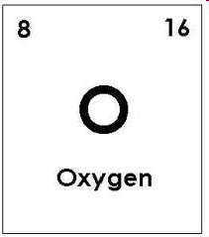
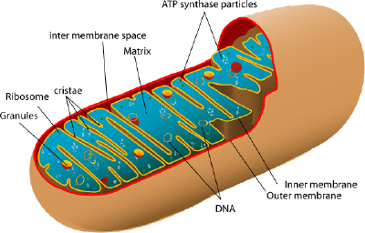
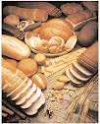
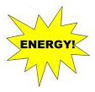
Aerobic Respiration
Biology
Unit 3
Lesson 7

Slide 7
Fruit Machine Review: 10 minutes
What kind of energy does cellular respiration begin with? What kind of energy ends cellular respiration?
What does anaerobic respiration mean?
How many stages of cellular respiration are there?
What is the name of the first stage?
In glycolysis, what reactant is used?
What three temporary products are made?
Where does glycolysis take place?
Is glycolysis anaerobic or aerobic?
What will happen after glycolysis in a cell if no oxygen is present?
How are the formula for cellular respiration and the formula for photosynthesis related?
In what types of organisms does cellular respiration occur?

Slide 8
Reading and Foldable Review (5 minutes)
Look over your work from Friday. Make sure you have completed Questions 1-4 under Krebs Cycle and ETC. If you’ve finished that, work on your checkmarks.
If you’ve finished BOTH, work on filling out your key points. See if you can guess what goes in each blank.

Slide 9
Review
The first stage of cellular respiration is glycolysis
Anaerobic or aerobic respiration?
In what part of the cell does glycolysis occur?
During glycolysis, glucose is broken down and 2 ATP are produced

Slide 10
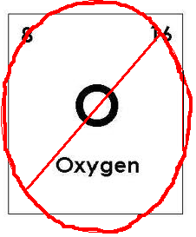
Lactic Acid Fermentation
Key Point 4: If no oxygen is available at the end of glycolysis, cells carry out an anaerobic process known as fermentation.

Slide 11
Lactic Acid Fermentation
During fermentation, which occurs in the cytoplasm, the 2 pyruvate are converted into lactic acid, but no more energy is produced
Lactic acid is what causes the burning sensation in muscles during intense exercise
This is why you “feel the burn”

Slide 12
Krebs Cycle
The second stage of cellular respiration is the Krebs Cycle (occurs when O2 is present)
CHECK: Is the Krebs cycle considered aerobic or anaerobic respiration?
Aerobic respiration
CHECK: In what part of the cell does the Krebs cycle occur?
Mitochondria
CHECK: What reactant is used during the Krebs cycle?
Oxygen (O2)

Slide 13
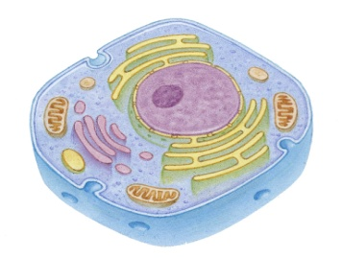
Krebs Cycle
Key Point 1: The second stage of cellular respiration, the Krebs cycle, occurs in the mitochondria and requires oxygen so it is considered aerobic respiration
What does aerobic mean?

Slide 14
Location

Slide 15
Krebs Cycle
Question 2: What gas is produced and released by cells during the Krebs cycle?
Carbon dioxide (CO2)
Question 3: What two electron carriers are produced during the Krebs cycle and used during the next stage?
NADH and FADH2

Slide 16
Krebs Cycle
Key Point 2: During the Krebs cycle, pyruvate is broken down and carbon dioxide (CO₂) is produced. 2 ATP and the electron carriers NADH and FADH2 are also produced.
CO2 is released by cells (in humans it enters the blood and goes to the lungs)
NADH and FADH2 are used in the third stage of cellular respiration

Slide 17
Krebs Cycle
Since glucose is split into two pyruvate molecules, the Krebs cycle occurs twice for each glucose molecule broken down during glycolysis

Slide 18
Electron Transport Chain
CHECK: Is the electron transport chain considered anaerobic or aerobic respiration?
Aerobic respiration
CHECK: In what part of the cell does the electron transport chain occur?
Mitochondria
CHECK: What reactant is used during the ETC?
Oxygen (O2)

Slide 19
Location

Slide 20
Electron Transport Chain (ETC)
Key Point 3: The final stage of cellular respiration, the electron transport chain, occurs in the mitochondria and uses oxygen, so it is also considered aerobic respiration
Review: what is the function of the mitochondria?

Slide 21
Electron Transport Chain (ETC)
What product of cellular respiration is formed during the electron transport chain?
Water (H2O)
How many total ATP are produced during the ETC?
32 ATP

Slide 22
Electron Transport Chain (ETC)
Key Point 4: During the electron transport chain, oxygen (O₂) and the electron carriers FADH₂ and NADH are used to produce 32 ATP, as well as water (H2O), from each glucose molecule
***This stage produces the most energy by far

Slide 23
Electron Transport Chain
Each NADH from glycolysis (2) produces 2 ATP through electron transport
4 total
Each NADH from the Krebs cycle (8) produces 3 ATP through electron transport
24 total
Each FADH₂ (2) produces 2 ATP
4 total
Overall, 32 ATP are produced through electron transport

Slide 24
Independent Review Questions
Two sections: Aerobic and anerobic respiration
Wall of Fame
If you finish…..study!
How?

Slide 25
Reminders!
Independent Questions: DO FOR HOMEWORK

