Slide 1
Catalyst #4: November 19th, 2012 (5 minutes)
  What does the cell do during interphase? (Cell Cycle Notes)
  During what stage of the cell cycle does a cell divide its genetic material between two new cells? (Cell Cycle Notes)
  What is chromatin? (Mitosis Vocabulary)
  What are chromosomes? (Mitosis Vocabulary sheet)

Slide 2
Today’s Agenda
Catalyst(5 minutes)
Mitosis and Cytokinesis (15 minutes)
Mitosis Manipulatives(10 minutes)
Review worksheet/Homework: When finish with manipulatives
Exit Ticket(5 minutes)
Homework:
  Mitosis Review worksheet

Slide 3
Announcements
Donate canned goods (first period) until November 30th!
Dojo review after break
Props

Slide 4
Unit 4: Guiding Questions
Why do cells have to reproduce?
How do cells reproduce and replace dying cells and allow an organism to grow?
What is cancer and what causes cancer?
Why do children have features of both of their parents?
Why do siblings (except identical twins) have different features?

Slide 5
Today’s SPI & Objectives
SPI 3210.1.6 Determine the relationship between cell growth and cell reproduction.
SWBAT explain the purpose of mitosis
SWBAT summarize the events of each phase of mitosis
SWBAT identify the phases of mitosis based on a figure

Slide 6
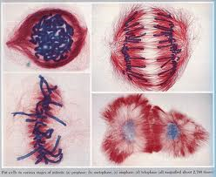
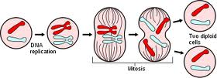
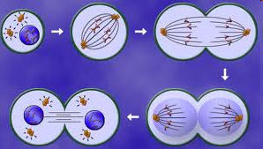
Mitosis and Cytokinesis
Biology
Unit 4
Lesson 4

Slide 7
Review
The cell cycle is how all non-reproductive cells grow, divide and reproduce
  Skin cells, muscle cells, blood cells, etc.
There are three stages in the cell cycle
  Interphase
  Mitosis
  Cytokinesis
At the end of the cell cycle, two identical daughter cells have been formed

Slide 8
Mitosis: Purpose
Key Point 1: The purpose of mitosis is to divide the cell’s nucleus and genetic material (DNA) among the two new daughter cells
  Each cell must have a copy of the same DNA

Slide 9
Mitosis
There are four phases of mitosis
  Prophase → Metaphase → Anaphase → Telophase

Slide 10
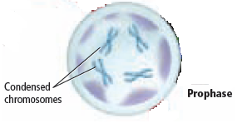
Prophase
Key Point 2: During prophase:
  Chromatin condenses into chromosomes
    Each chromosome looks like an X
  The nuclear membrane disintegrates (breaks down and disappears)
    Nuclear membrane= outer layer of nucleus
  Spindle fibers form

Slide 11
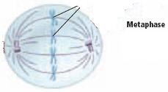
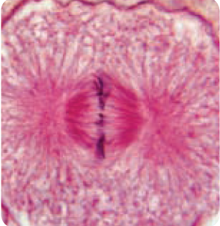
Metaphase
Key Point 3: During metaphase:
  Spindle fibers connect the centrioles to the centromeres of each chromosome
  Chromosomes line up along the middle of the cell
    Meta= middle

Slide 12
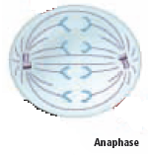
Anaphase
Key Point 4: During anaphase:
  Spindle fibers shorten, pulling the sister chromatids apart
  Sister chromatids move towards opposite ends of the cell
    Ana=opposite

Slide 13
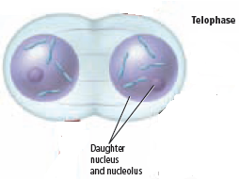
Telophase
Key Point 5: During telophase:
  Chromosomes relax back into chromatin
  The nuclear membrane reforms around the chromatin at each end of the cell

Slide 14
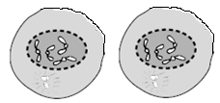
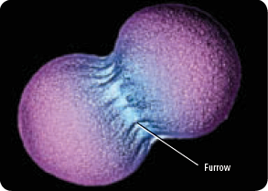
Cytokinesis
Key Point 6: During cytokinesis:
  Proteins pinch the middle of the cell at each end, forming a furrow
  The furrow divides the cytoplasm, splitting the cell into two new identical cells
  Plant cells form a cell plate instead of a furrow

Slide 15
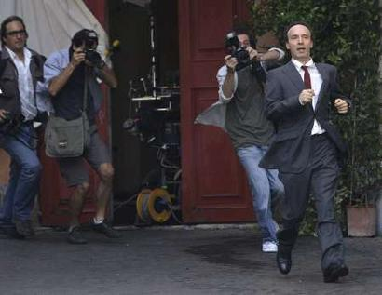
How do I remember all this???!
Italian Paparazzi Making All That Cash

Slide 16
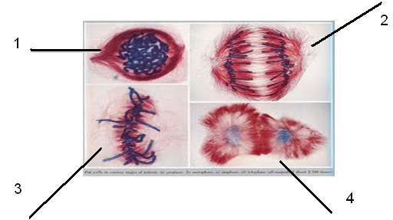
Check for understanding
What phase is each picture, and what is happening in each?

Slide 17
Mitosis Video
http://www.teachersdomain.org/asset/tdc02_vid_dnadivide/

Slide 18
Mitosis Manipulatives
On your own or with a partner,
  Sort the names of the phases into the proper order
  Match each picture with the name of the correct phase of mitosis
  Match the description of the phase with the correct phase of mitosis
Check your cards with Ms. M when complete

Slide 19
Review worksheet
When you finish your manipulatives: paper clip them and bring them to the front.
Grab a worksheet (everyone needs one) and start working on it.

Slide 20
Exit Ticket
Answer the following questions:
  Name the 4 phases of mitosis in the proper order.
  What happens during prophase?
  In what phase of mitosis do chromosomes line up along the middle of the cell?
  What phase is shown below?

Slide 21
Catalyst #5: November 20th, 2012: 8 minutes
ACT Problem of the week
Pg. 17 and 18
Problems: 17-21

Slide 22
Today’s Agenda
Catalyst(9 minutes)
Mitosis and Cytokinesis Flipbook (20 minutes)
Mitosis Review (10 minutes)
Homework: Eat good food.

Slide 23
Announcements
Donate canned goods (first period) until November 30th!
Dojo review after break

Slide 24
Unit 4: Guiding Questions
Why do cells have to reproduce?
How do cells reproduce and replace dying cells and allow an organism to grow?
What is cancer and what causes cancer?
Why do children have features of both of their parents?
Why do siblings (except identical twins) have different features?

Slide 25
Today’s SPI & Objectives
SPI 3210.1.6 Determine the relationship between cell growth and cell reproduction.
SWBAT explain the purpose of mitosis
SWBAT summarize the events of each phase of mitosis
SWBAT identify the phases of mitosis based on a figure

Slide 26
Mitosis and Cytokinesis
Biology
Unit 4
Lesson 4

Slide 27
Flipbooks
On the front of each flap write the name of each stage of the cell cycle
  Interphase
  Mitosis: Prophase
  Metaphase
  Anaphase
  Telophase
  Cytokinesis

Slide 28
On the inside of each flap, write a description of each stage.
Interphase (definition, G1, S, G2)
      Mitosis (definition)/Prophase (description)
      Metaphase (description)
      Anaphase (description)
      Telophase (description)
      Cytokinesis (definition)

Slide 29
On the inside of your flipbook (the part NOT cut), draw a picture of each phase

Slide 30
Mitosis Review
ActivExpressions Questions
Activ Expressions reminders

Slide 31
Quiz
By yourself.
Quietly.
In your seats.

Slide 32
Question one
1. What type of cell goes through the cell cycle?

Slide 33
Question two
2. Put the following stages of mitosis in order.
  A. Metaphase
  B. Telophase
  C. Prophase
  D. Anaphase

Slide 34
Question three
3. In which stage of mitosis are the sister chromatids pulled to opposite ends of the cell?
A. Metaphase
B. Anaphase
C. Cytokinesis

Slide 35
Question four
4. Why does the cell cycle need to happen? (Think about what would happen to an organism if their cells do not reproduce.)

Slide 36
Question five
Mitosis cell division produces
  A. Four genetically identical cell
  B. Two genetically identical cells
  C. Four genetically different cell

