Slide 1
Catalyst #2: November 15th 2012 (5 minutes)
What are somatic cells?
What is the cell cycle?
What type of cell does not divide through the cell cycle?
Why do cells have to reproduce?

Slide 2
Agenda
Catalyst (5 minutes)
ActivExpressions Introduction: 15 minutes
The Cell Cycle(15 minutes)
Exit Ticket (5 minutes)
Homework:
Read Section 9.1

Slide 3
Announcements
Today is the last day to make up your cellular respiration quiz.
Tuesday is last day to make up Unit 3 test.
Office hours today @3

Slide 4
Unit 4: Guiding Questions
Why do cells have to reproduce?
How do cells reproduce and replace dying cells and allow an organism to grow?
What is cancer and what causes cancer?
Why do children have features of both of their parents?
Why do siblings (except identical twins) have different features?

Slide 5
Today’s SPI & Objectives
SPI 3210.1.6 Determine the relationship between cell growth and cell reproduction.
SWBAT identify and summarize the three stages of the cell cycle
SWBAT identify and describe the individual stages of interphase

Slide 6
ActivExpressions!
Purpose
Procedure
Fun quiz

Slide 7
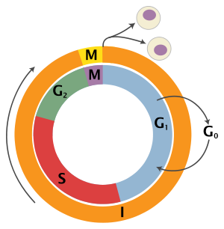
The Cell Cycle
Biology
Unit 4
Lesson 2

Slide 8
Review
Somatic cells are all of the non-reproductive (sex) cells that make up the body of an organism. Sex cells are sperm cells and egg cells.
Once cells reach their size limit they must either stop growing or divide
Cells divide and reproduce so that dead or dying cells can be replaced and so that organisms can grow
The process of growth and division by which all somatic cells reproduce is known as the cell cycle

Slide 9
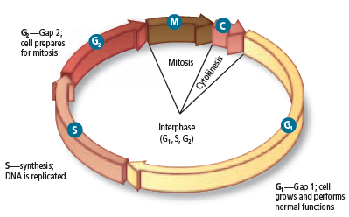
Stages of the Cell Cycle
Key Point 1: The cell cycle occurs in 3 consecutive stages: interphase, mitosis, and cytokinesis

Slide 10
Interphase
Key Point 2: During interphase: the cell grows, replicates its DNA, and makes proteins needed for cell division
Cells spend most of their time in interphase, so it is the longest stage

Slide 11
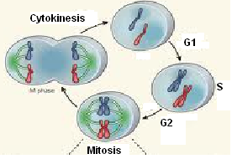
Sub-Stages of Interphase
Key Point 3: Interphase can be divided into 3 specific sub-stages

Slide 12
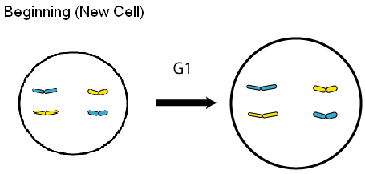
G1 (1st Gap) sTAGE
G₁ (1st Gap): the cell grows a lot and makes proteins called histones
Most of interphase is G₁
Copy drawing

Slide 13
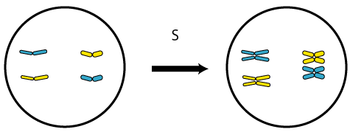
S (Synthesis) Stage
S (Synthesis): the cell replicates its DNA so that each new cell will have a copy of the same DNA
Copy drawing

Slide 14
G2 (2ND Gap) Stage
G₂ (2nd Gap): the cell prepares for mitosis and makes proteins needed for cell division
Proteins review

Slide 15
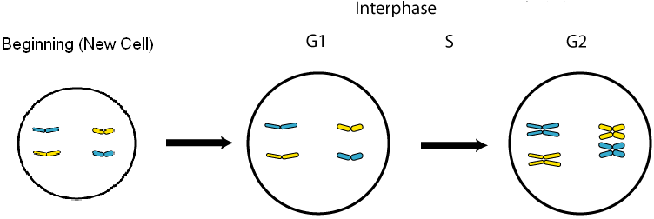
Interphase

Slide 16
Mitosis & Cytokinesis
Key Point 4: During mitosis, the cell distributes half of its genetic material (DNA) to each new daughter cell being formed
Each new cell then has a copy of the same DNA
Key Point 5: During cytokinesis, the cell actually divides into two separate daughter cells

Slide 17
The Cell Cycle

Slide 18
Exit Ticket: ActivExpression
What are the three stages of the cell cycle?
During which of the three stages of the cell cycle does the cell grow and replicate its DNA?
What happens during stage S of interphase?
During which of the three stages of the cell cycle is the genetic material (DNA) divided among the two cells?

