Slide 1
Catalyst #1: November 14th, 2012 (5 minutes)
What are all living organisms made up of?
Where do new cells come from?
What does the word “reproduce” mean?

Slide 2
Agenda
Catalyst (5 minutes)
Enzyme Review (10 minutes)
Introduction to Cell Growth and Reproduction (15 minutes)
Pick a corner(10 minutes)
Exit Ticket (3 minutes)
Homework:
Read section 9.1 in your book (pages 244-247)

Slide 3
Announcements
You have until next Tuesday to make up Unit 3 test.
Thursday is last day to make up Cellular Respiration quiz.
Office hours are Thursday @ 3.
Mastery levels are UP!!!!!

Slide 4
Enzyme review
You need your enzyme review worksheet.
Divided by sides. For every answer your team gets correct, you may choose one person to come to the board and complete a “challenge.”
The team that successfully wins the most challenges wins!
http://www.quia.com/mc/2494617.html

Slide 5
Enzyme review
You need your enzyme review worksheet.
Divided by sides. For every answer your team gets correct, you may choose one person to take a “trashketball” shot. Your team/person can choose a 3 pointer, 2 pointer, or 1 pointer.
The team that gets the most points WINS!!
Prize

Slide 6
Unit 4: Guiding Questions
Why do cells have to reproduce?
How do cells reproduce and replace old and dying cells?
What is cancer and what causes cancer?
Why do children have features of both of their parents?
Why do siblings (except identical twins) have different features?

Slide 7
Today’s SPI & Objectives
SPI 3210.1.6 Determine the relationship between cell growth and cell reproduction.
SWBAT define somatic cells and provide examples
SWBAT explain the relationship between cells, tissues, and organs
SWBAT define the cell cycle
SWBAT distinguish between cell growth and cell reproduction and explain the importance of cell reproduction

Slide 8
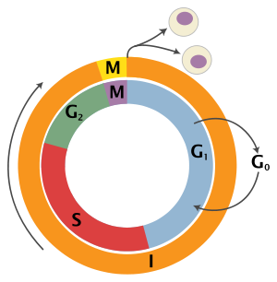
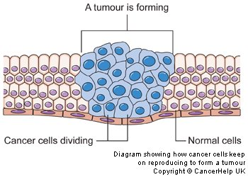
Introduction to Cell Growth and Reproduction
Biology
Unit 4
Lesson 1

Slide 9
Opening QUESTIONS
Answer Opening Questions 1-4 at the top of your notes (3 minutes)
Do you think that organisms contain the same cells from the time they form/are born to the time they die?
What types of cells in our body, if any, do you think need to reproduce?
Do you think that all cells divide and reproduce in the same way?
What do you think would happen if our cells could not divide and reproduce?

Slide 10
Somatic cells
Remember, all living organisms are made up of and organized into cells
Key Point 1: All of the cells of the body of an organism, except for reproductive (sex) cells, are known as somatic cells
Soma means “body”

Slide 11
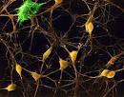
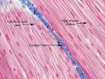
SOMATIC CELLS
What would be some examples of somatic cells in humans?
Examples: Skin cells, muscle cells, blood cells, nerve cells

Slide 12
CFU
T/F Brain cells are somatic cells.

Slide 13
Size Limits
Can cells continue to grow forever?
No
Cells have a size limit based on the ratio of surface area to volume
Key Point 2: Once cells reach their size limit, they must either stop growing or divide
Most cells will divide

Slide 14
Cellular reproduction
Where do new cells come from?
New cells can only come from previously existing cells
How do cells divide and reproduce?

Slide 15
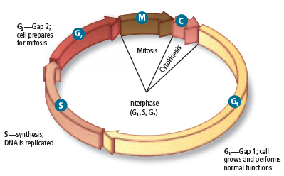
The CELL CYCLE
Key Point 3: The cell cycle is the process of growth and division by which all eukaryotic cells (except sex cells) reproduce
CFU: What are some examples of eukaryotic cells?

Slide 16
Structural Organization
How are cells organized in living things?
Key Point 4: Groups of cells that function together are known as tissues. Groups of tissues that function together are known as organs
Cells → tissues → organs

Slide 17
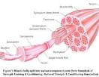
Cells → Tissue → Organs
Example:
Muscle cells → cardiac muscle tissue → heart (organ)
Other examples?

Slide 18
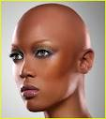
Purpose: WHY is this important??
What would happen if your hair cells did not reproduce?
What would happen if your blood cells did not reproduce?

Slide 19
Purpose
Key Point 5: Cells must reproduce in order to replace dead or dying cells so that tissues and organs can continue functioning properly
Cell division and reproduction makes sure that all parts of an organism are healthy

Slide 20
Pick a corner/Hold up a finger
Cover up your notes
Read the question on the board
Take 10 seconds to choose your answer
Move to the section of the room that corresponds with your answer
Be independent! Just because everyone chooses a corner DOES NOT mean it is correct!
Be prepared to defend your answer choice.

Slide 21
Question
What is the best definition of somatic cells?
All cells that do not contain nuclei
All of the reproductive cells in an organism
All cells of the body of an organism
All cells of the body of an organism, except for reproductive cells
Answer: D.

Slide 22
Question
Which of the following is not an example of a somatic cell?
Blood cells
Sperm cells
Muscles cells
Nerve cells
Answer: B. Sperm cells

Slide 23
Question
What two options does a cell have once it has reached its size limit?
Stop growing or die
Divide or die
Keep growing or divide
Stop growing or divide
Answer: D. Stop growing or divide

Slide 24
Question
What is the best description of the cell cycle?
The process of growth and division by which all somatic cells reproduce
The process of growth and division by which all cells reproduce
The process by which cells grow and mature but do not divide
The process by which cells produce energy for themselves
Answer: A.

Slide 25
Question
Which type of cell does not reproduce through the cell cycle?
Skin cells
Hair cells
Reproductive cells
Muscle cells
Answer: C. Reproductive cells

Slide 26
Question
How are tissues, cells, and organs organized from the smallest to largest level?
Cells → organs → tissues
Cells → tissues → organs
Organs → tissues → cells
Tissues → cells → organs
Answer: B.

Slide 27
Question
Which of the following best describes the relationship between cells, tissues, and organs?
Tissues and organs are different types of cells
Groups of organs form tissues and groups of tissues form cells
Groups of cells form tissues, and groups of tissues form organs
Groups of cells form organs, and groups of organs form tissues
Answer: C.

Slide 28
Question
Why must cells reproduce?
Cells must reproduce to provide organisms with new features
Cells must reproduce to replace dead cells and keep tissues and organs functioning properly
Cells must reproduce to form new organisms
Cells must reproduce to increase the size of tissues and organs
Answer: B.

Slide 29
Exit Ticket
Answer the questions below on the back of your warm up slip without using your notes
What are somatic cells and what is one example of a somatic cell?
What is the cell cycle?
How are cells, tissues, and organs related?
Why do cells reproduce?

