Slide 1
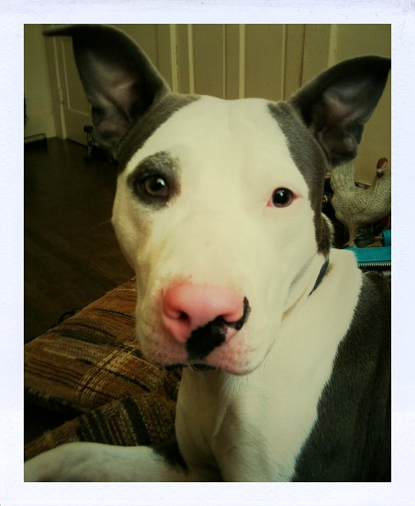
Catalyst
Give an example of incomplete dominance.
Give an example of codominance.
My neighbor has a pitbull that is gray and white. Is this an example of incomplete dominance or codominance?

Slide 2
Announcements
ThinkShow/Individual project
Class points!
Worksheet turn-in
WAIM sheet TBD**

Slide 3
Objectives
SWBAT analyze sex-linked inheritance patterns.
SWBAT explain how the environment can influence the phenotype of an organism.

Slide 4
Sex Determination
Each cell in our body contains ___________ pairs of chromosomes.
One pair of these chromosomes, sex chromosomes, determines an individual’s gender.
There are two types of sex chromosomes X and Y.
Individuals with two XX chromosomes are female; individuals with X and Y are male.
The other 22 pairs of chromosomes are called autosomes.

Slide 5
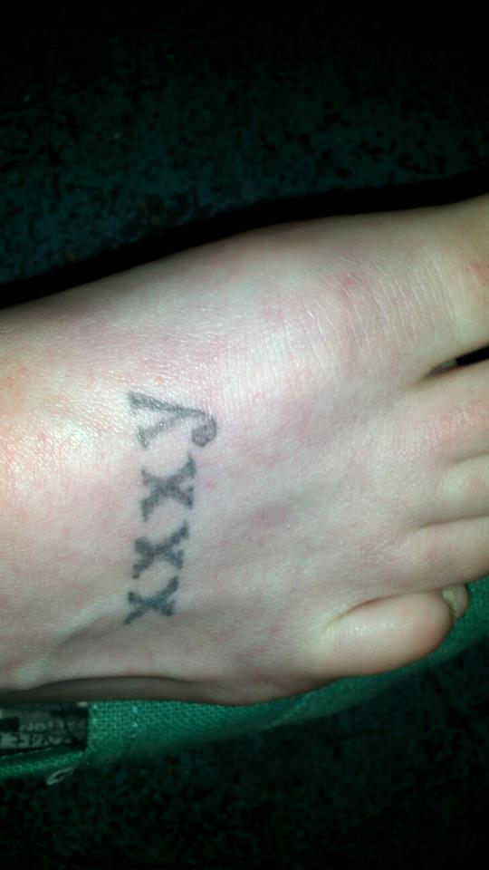

Slide 6
Video Questions
What is the most common form of color blindness?
What is it called when traits on the sex chromosomes are passed down?
Where do x-linked traits come from (mother or father)?
What type of allele causes red-green color blindness?
What is hemophilia?
Notes:
Red-green color blindness
Pattern sex-linked inheritance
Mother, because the male only has one x chromosome
A recessive allele
When blood does not properly cut; so a cut/scratch can cause intense bleeding

Slide 7
http://player.discoveryeducation.com/index.cfm?guidAssetId=787BD33A-E613-4742-B62E-06E5FC2883F1&blnFromSearch=1&productcode=US
http://player.discoveryeducation.com/index.cfm?guidAssetId=787BD33A-E613-4742-B62E-06E5FC2883F1&blnFromSearch=1&productcode=US

Slide 8
http://player.discoveryeducation.com/index.cfm?guidAssetId=787BD33A-E613-4742-B62E-06E5FC2883F1&blnFromSearch=1&productcode=US
http://player.discoveryeducation.com/index.cfm?guidAssetId=787BD33A-E613-4742-B62E-06E5FC2883F1&blnFromSearch=1&productcode=US

Slide 9
Sex-Linked Traits
Traits controlled by genes located on the X-chromosome are called sex-linked traits.
Males only have one X chromosome (XY), so they are affected by recessive X-linked traits more often than females. Because women have two X chromosomes (XX), the other X may mask the effect of the trait.

Slide 10
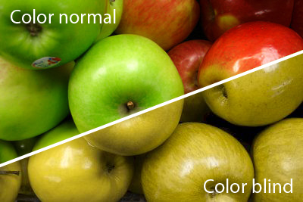
Red-Green Color Blindness
A recessive X-linked trait
8% of males in U.S.

Slide 11
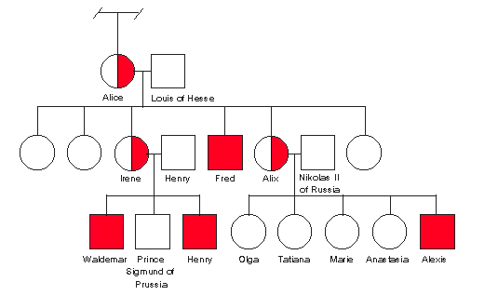
Hemophilia
Recessive sex-linked disorder
Delayed clotting of blood
The “Royal Disease”

Slide 12
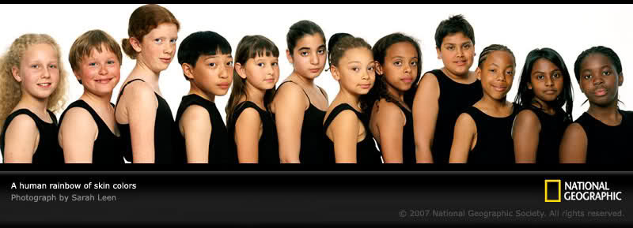
Polygenic Traits
Many phenotypic traits arise from the interaction of many genes.
Examples: skin color, fingerprint pattern

Slide 13
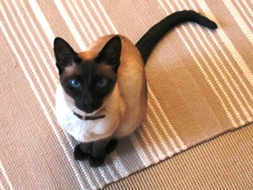
Environmental Influences
Sunlight and water: Plants can lose their leaves from lack of water; Without enough sunlight, most plants do not bear flowers.
Temperature: Influences expressions of genes

Slide 14
Twin Studies

Slide 15
Study Guide Work Time

