Slide 1
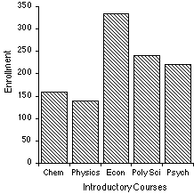
Catalyst
The bar graph below represents the declared majors of freshman enrolling at a university. Answer the following questions:
1. What is the total freshman enrollment of the college?
2. What percent of the students are majoring in physics?
3. How many students are majoring in economics?
4. How many more students major in poly sci than in psychology?
The ACT science test has a lot of charts and graphs. As part of our preparation, we will be practicing reading graphs A LOT this semester.
http://staff.tuhsd.k12.az.us/gfoster/standard/bgraph2.htm
Student-led
Catalyst review

Slide 2
Sixth period pop quiz
Come in, get out a sheet of paper and a writing utensil.
Nothing else should be on your desk.

Slide 3
Announcements
Last day to take Unit 5 test if you were absent
WAIM sheet on Thursday
Tutoring was canceled yesterday. I’m sorry!
Tutoring today!
DOJO lunches
Jobs

Slide 4
Pedigrees review: 5 minutes
What are pedigrees used for?
What symbols do we use to represent males and females?
When an individual’s circle/square is shaded, it means what?
An unshaded square means…
A horizontal line connects two people that are ________________.
How do we represent a carrier of that trait?

Slide 5
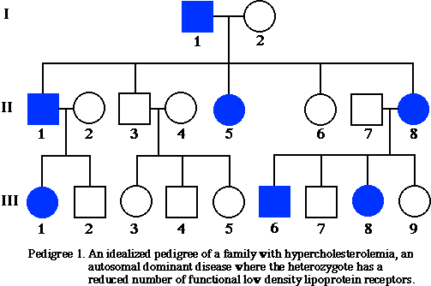
Pedigree

Slide 6
Today’s objective /Introduction: 5 minutes
Students will be able to construct (make) and analyze a pedigree displaying a family’s inheritance pattern for Tay-Sachs disease.
We are going to be taking what we learned about pedigrees yesterday and using it to build a pedigree for Tay-Sachs disorder.

Slide 7
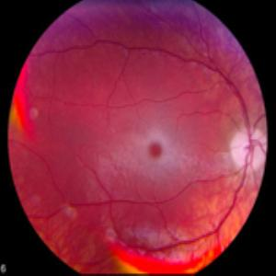
Tay-Sachs Review
Recessive or genetic disorder?
What genotype does an individual have to have in order to have this disorder?
Causes/Effects?
Life expectancy

Slide 8
Expectations
Like the Punnett Square packet, this will be a mixture of working as a class and working individually.
We will be doing “show-checks.”
You will need a separate sheet of paper/highlighter AND your pedigree notes!
As we read the introduction, we will have several “CFU” checkpoints. You will need to answer CFU questions on your own paper. I can call on anyone to answer these questions, so pay attention!

Slide 9
Tay-sachs disease: 10 minutes
CFU # 1: What is Tay-Sachs exactly?
CFU #2: Who is at risk and what can they do?
CFU #3: What is the other 25% chance?
CFU #4: What type of test can be done to screen for the Tay-Sachs gene?
CFU #5: What is a chroronic villus sampling?
CFU #6: What will happen to a child with Tay-Sachs?

Slide 10
Pedigree work time: 20 minutes
Step 1: Together

Slide 11
Pedigree cont.
Step 2: Individual/Review

Slide 12
Pedigree cont.
Step 3: Individual

Slide 13
Exit ticket
Answer the four questions at the bottom of your pedigree assignment sheet on your sheet of paper.
You must rewrite the questions and answer them at the bottom of your pedigree.

